Slide 1
Celebrating Failure as an Essential Part of Learning
Martine Ceberio
Professor and Associate Dean
The University of Texas at El Paso

Slide 2
Some Context
UT El Paso is an open access institution
85% of UG students are Hispanic
College of Engineering: > 5,000 students
Computer Science: ~1,400 students
My average class size: 60-100 UG, 30 MS/PhD

Slide 3
Today’s Plan
What we Know about Failure & Learning
The Good about Failure
The Barriers to Embracing Failure
Ideas about How to Embrace It
BUT ALSO: Your Input

Slide 4
Why Talk about Failure?
One may wonder… Aren’t we supposed to guide students to succeed, not fail?
Studies about the productivity of struggling (yes, struggling is not failing, but getting close, being comfortable with the possibility of failing), course design for productive failure too
Failure in life outside of school
Some talk about failure, normalizing struggle and failure in a time of online polished stories

Slide 5
Everyone talks about it
Failure is inevitable
“Failure is success in progress.” - Albert Einstein
“If you are not confused, you are not paying attention” – Tom Peters
[In real life] “nobody scores you on a failure provided you end up on a success” – Jeff Olson, President of Hiller Measurements
“Failure is inevitable. Learn from it, and move on” – Roger Federer
“Fail early, fail often, but always fail forward” – John C. Maxwell
“Most great people have achieved their greatest success just one step beyond their greatest failure” – Napoleon Hill

Slide 6
(Science) Faculty Value Failure
Transferrable experiences and skills
Failure = opportunity to:
Refine experiments
Change viewpoint
Reflect & modify study habits
Build resiliency and productive coping, productively engage in failure

Slide 7
More Concretely… about Learning
Mathematician David Bessis urges the development of mental models, even if incorrect, as a starting point → we need them to build correct ones over time
He further stresses the value in learning to be comfortable with being wrong.
Math achievement US vs Japan ← struggle time = 10% vs 55%
Fear of failing
→ detrimental to memorization and to learning

Slide 8
Towards Enhanced Learning?
Learning is enhanced when students:
Engaged, not afraid
Emotions, Fun
First form answers
Are surprised by the actual answer
(e.g, productive failure)
Action, trial and error, emotion (surprise, fun) = learning
Fun fact:
Engaged & safe → same brain wavelengths
BUT: Students must be willing to play

Slide 9
Let’s Pause for a Moment…
Failure in my classes:
Work that does not yield the expected solution (not: no work)
E.g., failing to reach a conclusion in a proof of correctness, or to build a rigorous argument, failure to properly analyze the time complexity of a function.
What does failure look like in your classes?
Take a few minutes to think about it, share it at your tables, then report

Slide 10
Let’s Take a Look at Students’ Experience & What They Think

Slide 11
How is Failure Handled in Education and Beyond?
Mostly not an option: grades as currency
GPA is attuned to personal currency
Grades are assigned and for the most part, students have to “live with them”
GPA race, ramping up as students prepare to enter college
Stigma of failure: Societal & family pressures
How about as faculty? Admitting weaknesses? Trying a new pedagogy in class and failing or simply receiving lower student evaluations?

Slide 12
What Do Students Say about Failure?
“People often tend to judge others for not meeting certain standards […]. The fear here is having people talk and laugh about my failures and using the failures to create their own opinion of who I am as a person”
“I fear that failure is irreversible”
“It is easy to preach about the importance of failure […], but it doesn’t change the fact that every little thing you do in school is graded and people are passed or failed, which can ruin someone chance at getting into a program or school.”
[Nunes et al. Decreasing the Stigma of Failure in STEM Students, 2021]

Slide 13
A Little Logic Puzzle
+ evidence:
no struggle
→ less learning
Failure (&/or struggle) → Learning
Students = failure-averse →? Not learning? = this is a logic fallacy
Also: fear → not learning
No fear → learning? = another fallacy
Problem at hand: Students: fear of failure → not Learning
Solution at hand? Drop the fear of failure, use it → Learning

Slide 14
Dropping the Fear of Failure?
How?
Acknowledging our students’ foci:
It is not what we think matters (learning), it is what they think matters (grades and outcomes, for an internship, a good job, etc. … and learning)
They care about what people will think about their failures (we are no different)

Slide 15
So, What Can We Do?
Attending to our students’ sense of safety:
Just like we create identity and psychologically safe environments → failure-safe
Normalize struggle and failure
Remember the brain waves experiment?
Then we can hope to reignite the joy and fun in learning

Slide 16
My First Steps
UTEP is an open-access institution
Access is not enough
My challenge: allowing different paces of learning
While still celebrating learning when it takes place
Grading should not penalize the pace of learning
Allowing to celebrate the journey = the process (instead of lamenting it takes too long)
Grading for mastery
Notes:
Access is helping some get through the door one way, and others in through a different entry point. Access needs to be a multipronged approach.

Slide 17
How did that go?
Pretty bad (only a slight exaggeration…)
Confused students → not great to decrease fear and increase safety…
What I brought: enthusiasm
What I missed: student’s need for a grade, for safety

Slide 18
How about you all?
My experience was not successful at first
More on this soon…
What would including failure bring to your classes?
What do you foresee as the risk(s) of integrating failure?
Take a few minutes to think about it, share it at your tables, then report

Slide 19
Idea Reboot
My goals:
Making students comfortable:
1. About their grade → they are in the know
2. About being uncomfortable → normalizing failure & struggle
Making failure harmless → no grade to live with (as much as possible)
How did I do it?
Notes:
For both UG and G students

Slide 20
My Approach
Lots of assessments
Not particularly about low-stakes vs. high-stakes
Work is expected
Grade is registered when skill is mastered
Lots of communication
Sharing my philosophy – a lot of work at first, slightly less so now (they know ☺ )
Guiding students to proper study habits (absences, misguided study habit, procrastination, etc.)
Training of my team (when I have TAs)

Slide 21
The Cost of It
Time: grading, providing feedback, assessing standing, meeting with students
Efforts: incl. communication, team training
Risk of poor feedback
Find tools that work for you
+ Assess what you want to achieve vs what you can do

Slide 22
What do students say about it?
rather than feeling discouraged from a failing grade, her grading technique gave me a sense of “Okay, I did good in these questions, and I need to keep practicing in these other areas I didn’t do so well in, so now I know what areas to target” all without making me feel like I’m not smart enough
It made it feel like failure is a natural part of learning and failure helped me to improve and ultimately got an A in the class
Failure was not a big deal for sure.
I can stress less about it and focus on next topics instead of just feeling bad and wanting to give up.
If I got a bad grade I said to myself "Ok I need to do better" so I looked back at what I messed up on and practiced it until I improved.
She’s the main reason I wasn’t
afraid of struggling because she
was always there when i needed her.
I felt less stress and less test anxiety

Slide 23
Does That Really Work?… & on the Long Run?
Prior preparedness does not matter in succeeding anymore
Students push through → fewer drops
They understand that what’s behind them is behind them: what matters is what you do with it (like Roger Federer says of his tennis points ☺)
Students who would have failed under a traditional grading system now pass the class (about 80% of those who would have failed pass)
And go on to be successful in the subsequent courses

Slide 24
Thank you!
Are there any questions?
Let’s continue the conversation if time allows
Please feel free to reach out at: mceberio@utep.edu

Slide 25
Some References
Allen, K., Monyer, H. The highs and lows of memory. Nature 504, 228–229 (2013). https://doi.org/10.1038/504228a
D. Bessis, “Mathematica, une aventure au coeur de nous-mêmes,” Editions du Seuil.
Canning, E. A., Ozier, E., Williams, H. E., AlRasheed, R., & Murphy, M. C. (2022). Professors Who Signal a Fixed Mindset About Ability Undermine Women’s Performance in STEM. Social Psychological and Personality Science, 13(5), 927-937. https://doi.org/10.1177/19485506211030398
Elizabeth A. Canning, Katherine Muenks, Dorainne J. Green and Mary C. Murphy. “STEM faculty who believe ability is fixed have larger racial achievement gaps and inspire less student motivation in their classes.” In Science Advances, vol. 5, issue 2. 2019. eISSN2375-2548. Publisher: American Association for the Advancement of Science
Cannon, M. “Accidental Discoveries and Breakthroughs”, https://www.mynewlab.com/blog/accidental-scientific-discoveries-and-breakthroughs/#
Min Derry, University of Pennsylvania. “Reflection: The Necessity of Failure.” https://weingartencenter.universitylife.upenn.edu/bigger-pictures-the-necessity-of-failure/
Dong Anmei , Jong Morris Siu-Yung , King Ronnel B. “How Does Prior Knowledge Influence Learning Engagement? The Mediating Roles of Cognitive Load and Help-Seeking”. Frontiers in Psychology, vol. 11, 2020, https://www.frontiersin.org/journals/psychology/articles/10.3389/fpsyg.2020.591203. DOI=10.3389/fpsyg.2020.591203
A.C. Edmonson, “The Fearless Organization: Creating Psychological Safety in the Workplace for Learning, Innovation, and Growth”, Eds Wiley, 2018

Slide 26
Federer, R. “Lessons on Failure and Successes”, 2024.
Feldman, J. “Grading for Equity”, 2023
Flint, A. S., & Jaggers, W. (2021). You matter here: The impact of asset-based pedagogies on learning. Theory Into Practice, 60(3), 254–264. https://doi.org/10.1080/00405841.2021.1911483
Guskey, T. “On Your Mark”, 2014
Helbig and Norman, “The Psychological Safety Playbook: Lead More Powerfully by Being More Human”
O. Houdé, “L’école du cerveau, de Montessori, Freinet et Piaget aux sciences cognitives,”Editions Mardaga
Kapur, M. “Productive Failure”, https://www.manukapur.com/productive-failure/
Mattingly, V., Grice, S., Goldstein, A. “Inclusalytics: How Diversity, Equity, and Inclusion Leaders use Data to Drive their Work”, 2022
Mein, Erika L.. “Asset-Based Teaching and Learning with Diverse Learners in Postsecondary Settings.” (2018).
Nunes K, Du S, Philip R, Mourad MM, Mansoor Z, Laliberté N, Rawle F. Science students' perspectives on how to decrease the stigma of failure. FEBS Open Bio. 2022 Jan;12(1):24-37. doi: 10.1002/2211-5463.13345. Epub 2021 Dec 13. PMID: 34873880; PMCID: PMC8727946.
S. Sanford, “Inclusion, Inc.: How to Design Intersectional Equity into the Workplace”, 2022
Student Experience Project, https://studentexperienceproject.org

Slide 27
Embracing failure, Creating a safe place, & enhancing Equity in your classroom
Some context about UTEP
Our philosophy is: access BUT access without inclusion and equity is useless
Grading should not penalize the learning process or the student’s situation
Leveling the playing field
Mastery instead of journey
Inclusion, Inc., Sanford S. // Inclusalytics: How Diversity, Equity, and Inclusion Leaders use Data to Drive their Work, Mattingly, V., Grice, S., Goldstein, A. // Grading for Equity, Feldman, J. // On Your Mark, Guskey, T.

Slide 28
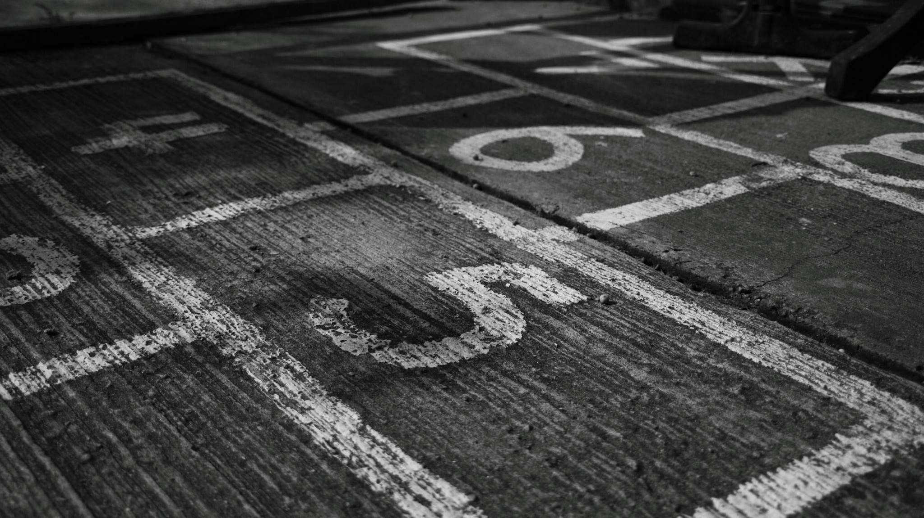
What’s Stopping Us?

Slide 29
Safety for more Learning
Safe environment, psychological safety: including failure-safe, identity-safe
Normalizing failure and struggle
Brain waves professor/students: synchronous when students are engaged & feel safe
Reconciling students with learning and the joy of learning, a playground
The Psychological Safety Playbook: Lead More Powerfully by Being More Human Lead More Powerfully by Being More Human, Helbig & Norman // The Fearless Organization: Creating Psychological Safety in the Workplace for Learning, Innovation, and Growth, Edmondson
Notes:
This brings me to talk about safety.
This is all interconnected and we could take any of these topics (fear, safety, and later equity) and address them in any order as they reinforce each other
Reinforcing in class our philosophy about creating a safe environment where everyone is welcome, every identity and background, including academic background, that we are there to work together.
NORMALIZING FAILURE AND STRUGGLE
Recognizing “failure” as a step in the right direction, not a wrong direction to be corrected, most of the times
I compare my class and the semester to a playground: this is our safe place, to practice, learn, grow, at our own pace, with our own style.
Interestingly about when students are willing to play and are engaged, a study by Houdé showed that the brain waves (the cerebral activity) of teacher and students are in synch.

