Slide 1
Elevating Student Success through Collaboration and Innovation
Louie Rodriguez (Provost Office)
& Martine Ceberio (College of Engineering)

Slide 2
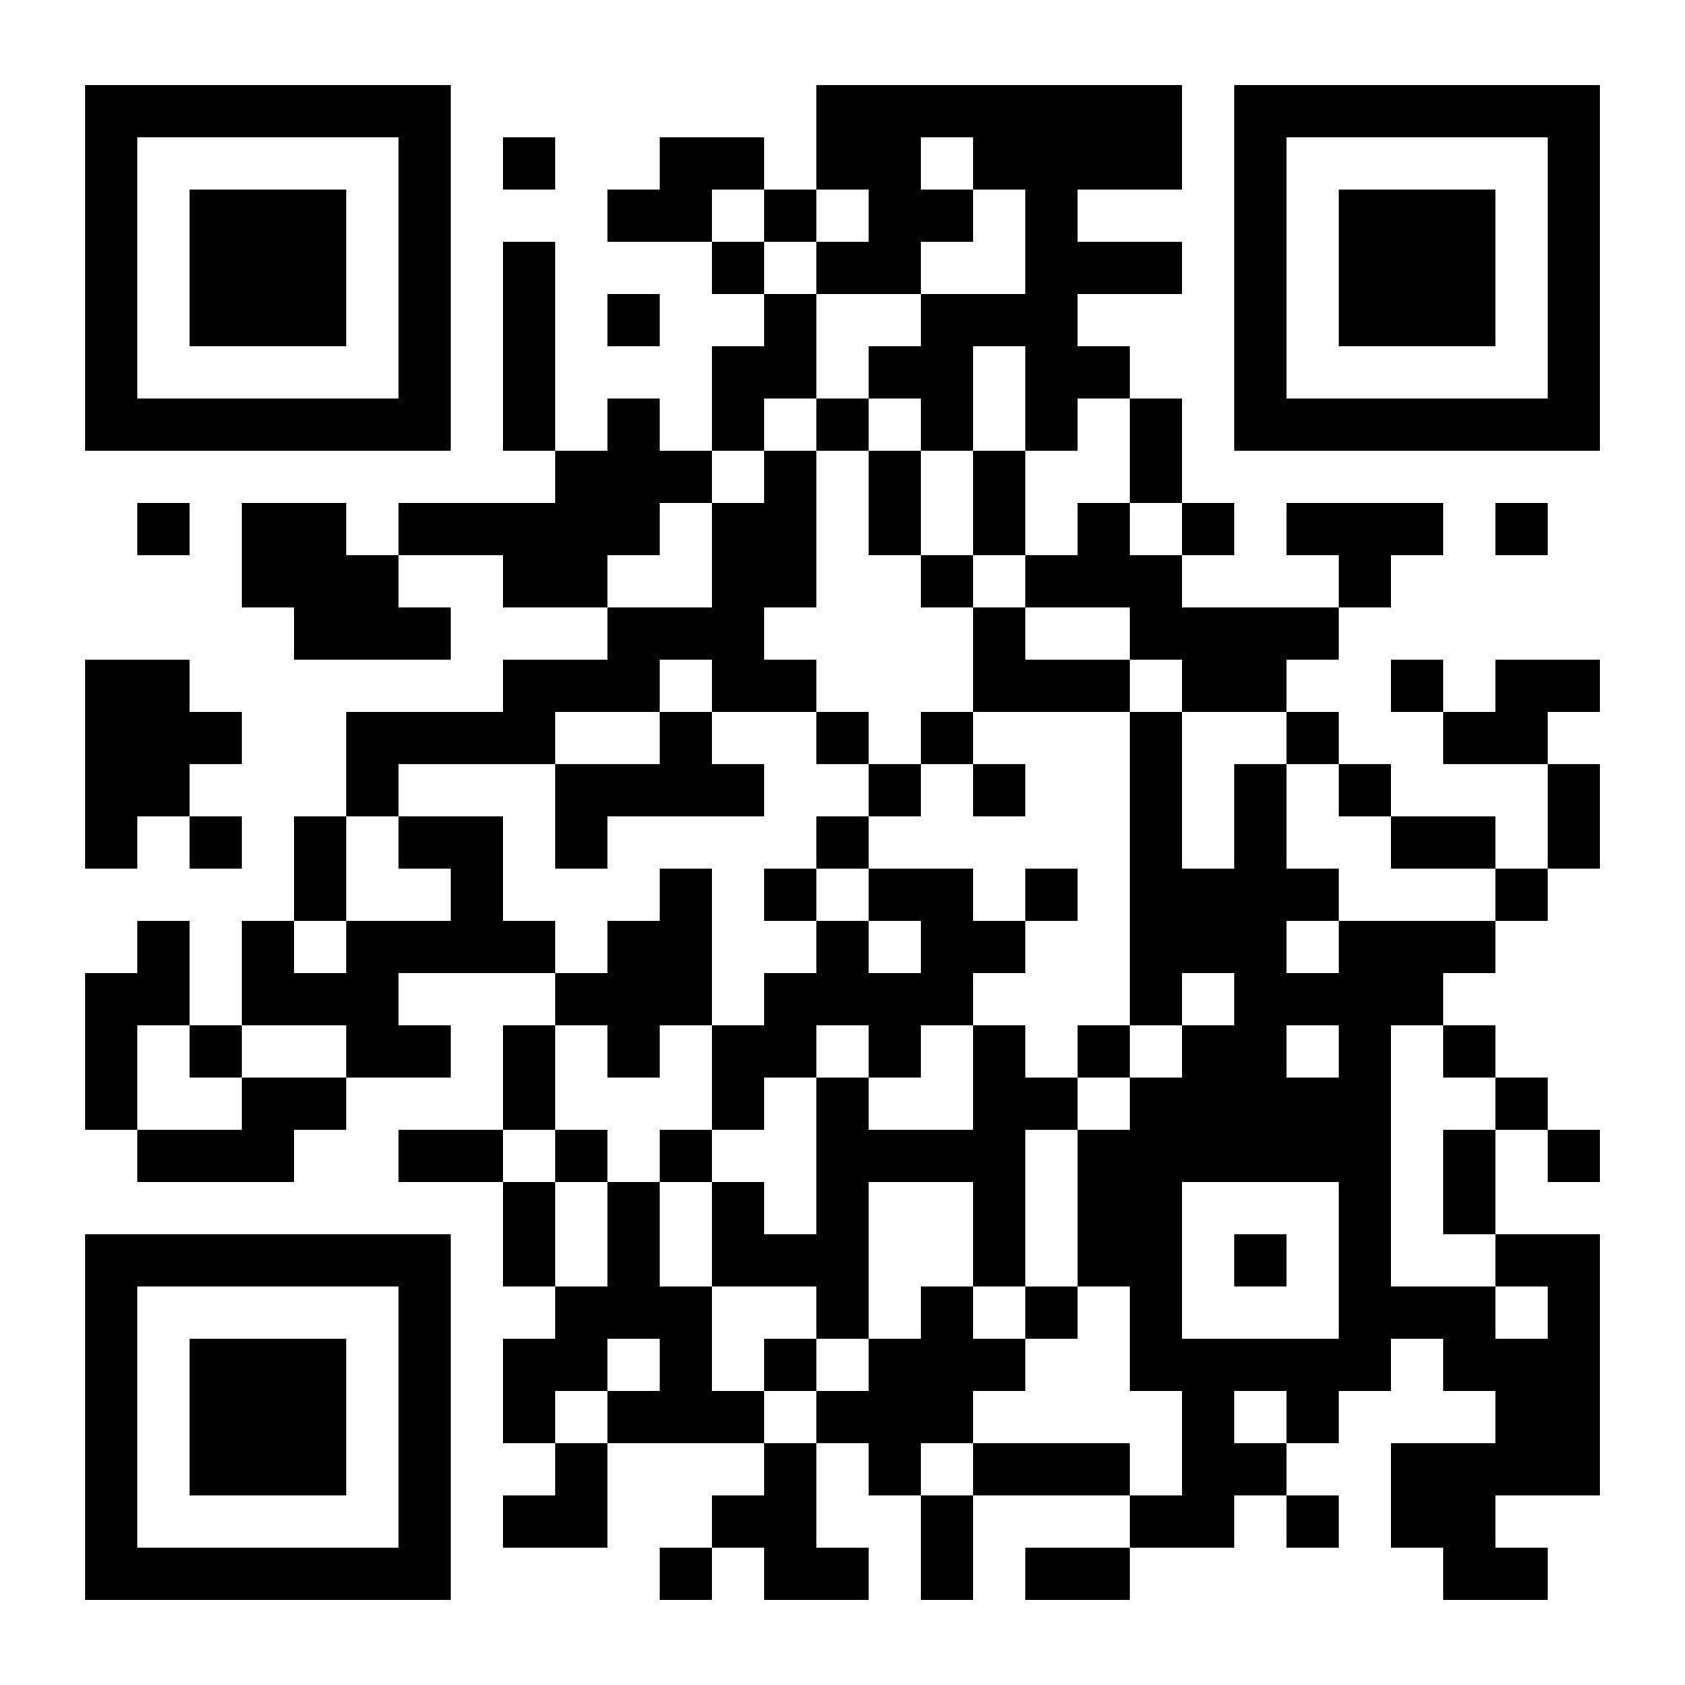
Simple Changes for a Big Impact
Communication tone
Meaningful policies
Feedback
Safety

Slide 3
Communication Tone
Growth mindset
Normalizing struggle
Showing care

Slide 4
Please download and install the Slido app on all computers you use
What comes to mind when you hear “Growth Mindset”?
ⓘ Start presenting to display the poll results on this slide.

Slide 5
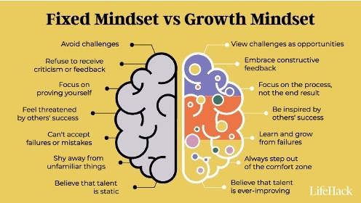
Communication Tone

Slide 6
Communication Tone
Does your syllabus communicate your growth mindset?
Does it communicate that it is normal to feel challenged and to struggle?
Does it communicate that you care about your students’ success?

Slide 7
What do you think?
Given these two syllabi excerpts, what do you think about how they communicate (or not) a growth mindset?
“This is a difficult course. Succeeding on tests and assignments will require a thorough understanding of the course material. Students who are not quick learners should consider dropping the course now.”
“This is a difficult course, but it is possible to learn this material. If you find yourself struggling, I suggest you put in more effort.”

Slide 8
Please download and install the Slido app on all computers you use
1. “This is a difficult course. Succeeding on tests and assignments will require a thorough understanding of the course material. Students who are not quick learners should consider dropping the course now.” 2. “This is a difficult course, but it is possible to learn this material. If you find yourself struggling, I suggest you put in more effort.” Which excerpt (if any) conveys a growth mindset?
ⓘ Start presenting to display the poll results on this slide.

Slide 9
Meaningful Policies
Syllabus revision (incl. for communication tone)
Examples:
Late work policy (or not): What is it? How do you word it?
Attendance: Does attendance count in your grade? Why? Do you word it negatively or positively?

Slide 10
Feedback
What’s the point of assessing our students?
How best can we use it?
Meaningful & timely feedback

Slide 11
Safety
Dropping the fear level, making students feel safe (identity, failure, psychological safety)
“Psychological safety is a belief that one will not be punished or humiliated for speaking up with ideas, questions, or mistakes” [Amy C. Edmondson, Novartis Professor of Leadership and Management at Harvard Business School]
Fear and stress negatively affect learning, with very bad effects on memory

Slide 12
Please download and install the Slido app on all computers you use
What are words that come to mind when you think about ensuring psychological safety in your classrooms?
ⓘ Start presenting to display the poll results on this slide.

Slide 13
Impact
Increased students’ belonging and academic success

Slide 14
Demonstrated Impact
Grounded in social psychology research: https://accelerateequity.org/resource/practices-library/library-references/
Within SEP:
Increased chances of As & Bs
Decreased DFWs

Slide 15
How Do We know?
Partnership with Ascend:
3 surveys per semester (10 minutes, 5 minutes, 5 minutes)
Smooth access to a portal with all access and result details
Your results are not shared with anyone but you
Simple way to assess your impact and document your changes

Slide 16
Campus Initiative around the Student Experience Project
Community of Practice
Participants: 34 faculty across campus, total enrollment of 2121
Partner: Ascend → students’ surveys to assess impact
Training: 4 workshops, 4 CoP discussions, 3 surveys (Fall semester)
Responses: 2118 (out of 2121)
SEP is supported by the Raikes Foundation, along with a partnership of the Association of Public and Land-grant Universities (APLU), Coalition of Urban Serving Universities (USU); College Transition Collaborative (CTC, now part of Equity Accelerator); Education Counsel; Project for Education Research that Scales (PERTS); and Shift.

Slide 17
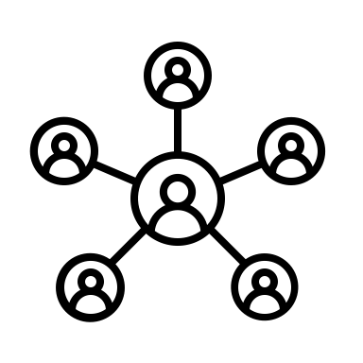
What if You could Join in this Effort?
Interested in hearing more? →
Next cohort: Fall 2025
Recruitment: Spring 2025
Kick-off: Early June 2025
Workshop 1: Friday before Fall semester starts
Typically: 1 workshop / 1 CoP discussion per month

Slide 18
Thank You For Your Attention!
Are there any questions?
Please feel free to contact me at: mceberio@utep.edu

