Slide 1
Let’s Talk about Students’ Success
Towards More Learning and Equity in the Classroom
Martine Ceberio
Computer Science Professor
Associate Dean of Engineering for People, Culture, and Environment
The University of Texas at El Paso
mceberio@utep.edu
Notes:
Introduce myself

Slide 2
A little bit about me
PhD in Computer Science from the University of Nantes, France (2003)
At UTEP (since 2003): now professor
Associate Dean of Engineering for People, Culture, and Environment (since 2023)
Passions: broadening participating in computing, teaching, research in decision under uncertainty

Slide 3
The University of Texas at El Paso UTEP
Located on the border of Mexico and New Mexico (on Mountain Time)
Hispanic-Serving Institution (HSI): 85% of UG students are Hispanic
Open-access institution
Close to 5,000 students in Engineering
About 1,400 students in CS
My class sizes: UG 60, G 30
But UG classes I teach will be 120-200 next time I teach them
Note the Bhutanese architecture, and temple.
Mexico (Ciudad Juarez) is in the background.

Slide 4
Before we go any farther…
5 minutes and then let’s share
with the whole group
Who are your students?
Take a moment to share at your table: the assets of your students, but also the barriers you see them face
UTEP students: bi-lingual, work outside campus,
support their family, very driven
Barriers: lack of role models, lack of opportunities,
impostor syndrome, very broad range of preparedness…
Notes:
Before to go any farther, I would like to hear from you about your students.

Slide 5
Today’s GOALS
A few easy practices
What they are
What they look like: examples
How to integrate them into your classroom
But I also want to hear from you and
engage you in reflections about
your practices
Notes:
We understand everybody is busy, our curricula are packed. It is hard to fit any more stuff, or to find the time to train, prepare, etc.
The practices I will share, I have used, some I have developed. Recently I have joined the Student Experience Project.
I teach classes of 50-60 UG, 30-ish G. I may teach larger classes. I know it works.

Slide 6
More specifically…
Teaching mindset
Course policies
Grading and assessing
Keeping in mind that we are looking for “easy” changes
Notes:
We will go over practices that relate to 3 areas of our teaching:
1/ first our mindset as we engage in teaching
2/ our course policies: just like anything, they need revising periodically
3/ finally, grading and assessing. This is ultimately our contract to the students. It needs to be consistent with our narrative as teachers, our philosophy

Slide 7
Teaching mindset
Asset-based teaching
Growth mindset
For increased learning and sense of belonging

Slide 8
Asset-based teaching
Draws on students’ interests, making the course content more relatable
Focuses on what students bring to the classroom instead of on what they lack → Highlights and values students’ differences and strengths
Flint, A. S., & Jaggers, W. (2021). You matter here: The impact of asset-based pedagogies on learning.
Theory Into Practice, 60(3), 254–264. https://doi.org/10.1080/00405841.2021.1911483
Mein, Erika L.. “Asset-Based Teaching and Learning with Diverse Learners in Postsecondary Settings.” (2018).

Slide 9
Asset-based teaching
How-to examples of Validating students’ prior experiences
Relating to prior knowledge => more learning (win-win)
E.g., in Computer Science: daily activities and how students use problem-solving and algorithmic structures without knowing → bringing this up helps them build new knowledge
E.g., with bilingual students: allowing them to work in their other language, or relating to the translation of it, allowing students to work in groups of similar language, etc.
Dong Anmei , Jong Morris Siu-Yung , King Ronnel B. “How Does Prior Knowledge Influence Learning Engagement? The Mediating Roles of Cognitive Load and Help-Seeking”.
Frontiers in Psychology, vol. 11, 2020, https://www.frontiersin.org/journals/psychology/articles/10.3389/fpsyg.2020.591203. DOI=10.3389/fpsyg.2020.591203

Slide 10
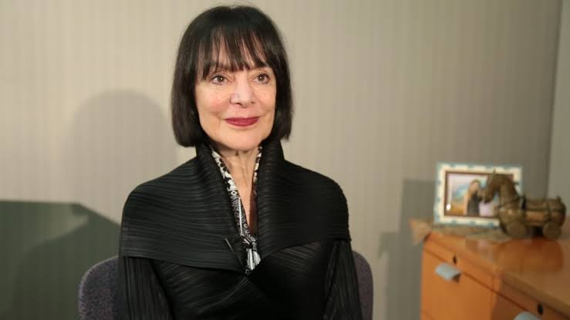
Growth mindset
Term coined by Carol Dweck
We can improve our skills as opposed to (fixed mindset) being born with a given capital
Skills can be developed through dedication and hard work
Carol Dweck, David S. Yeager. “A Growth Mindset about Intelligence,” pp. 9—35, in the Handbook of Wise Interventions, How Social Psychology Can
Help People Change. 2020. Editors: Alia J. Crum, Gregory M. Walton.

Slide 11
Growth mindset: why and how?
Why is it important?
Encourage students to have a growth mindset → It equips them against damaging thoughts about their performance (e.g., “I got a C, I do not belong”)
Model a growth mindset as an instructor → acknowledge your own path, errors, meet students’ struggles with a positive attitude
Results:
Failure does not define you
Students’ motivation remains up
Students persist more → increased retention and success
Canning, E. A., Ozier, E., Williams, H. E., AlRasheed, R., & Murphy, M. C. (2022). Professors Who Signal a Fixed Mindset About Ability Undermine Women’s Performance in STEM. Social
Psychological and Personality Science, 13(5), 927-937. https://doi.org/10.1177/19485506211030398
Elizabeth A. Canning, Katherine Muenks, Dorainne J. Green and Mary C. Murphy. “STEM faculty who believe ability is fixed have larger racial achievement gaps and inspire less student
motivation in their classes.” In Science Advances, vol. 5, issue 2. 2019. eISSN2375-2548. Publisher: American Association for the Advancement of Science
Notes:
As a matter of fact, a fixed mindset in teachers is proven to be damaging to students, in particular to minorities

Slide 12
How to spread a growth mindset? Examples
Encourage and normalize struggle
Remind students of the elasticity of their brain
Celebrate achievements and encourage students to reflect
Use “yet” a lot: “you do not understand this concept **yet**” → side effect: we give feedback a lot more clearly

Slide 13
Asset-based teaching and growth mindset in your classrooms
At your table:
Share one strategy that you do not use and why
Share one strategy that you use: (or are planning to use)
Asset-based or growth mindset?
What are the results?
What are the hurdles?
Take a few minutes on this and then let’s reconvene

Slide 14
Teaching mindset: your thoughts
Notes:
Does any of you find it hard to spread growth mindset?
How about asset-based teaching? What is the biggest barrier?

Slide 15
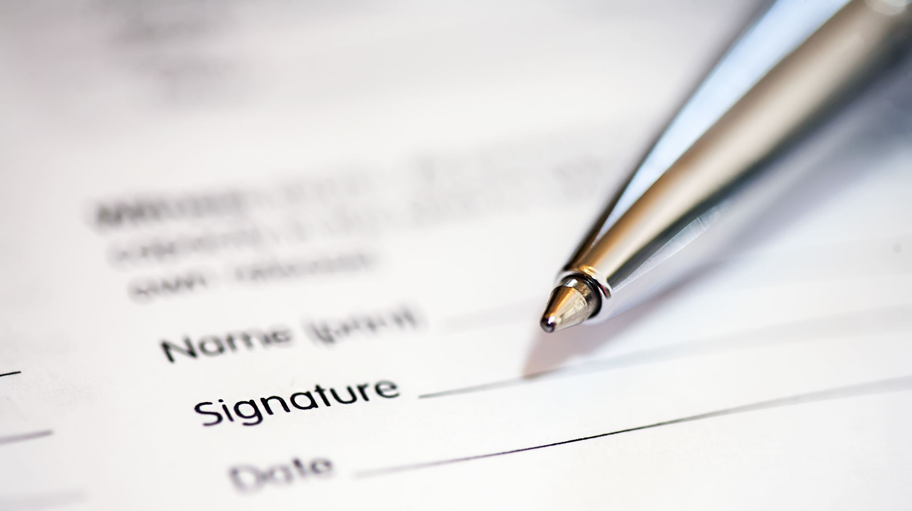
How about policies?

Slide 16
Policies may say a lot about your mindset
Important to review them periodically:
Do they still make sense?
Why do I enforce them?
What am I trying to achieve?
What do students read?
Gap between what we mean and what we write?

Slide 17
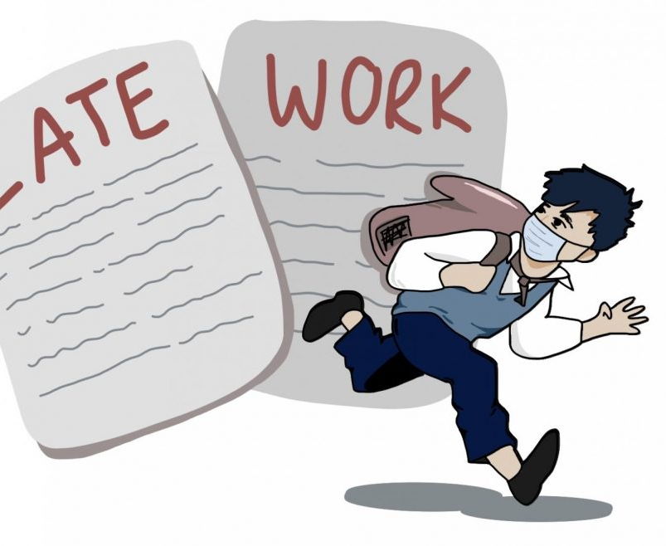
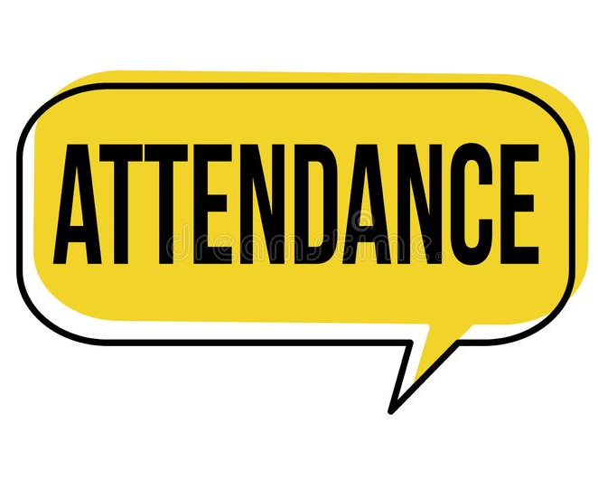
Policies: examples
Late work policy
10 points off per day of lateness
0 after 3 days
What do we want to achieve with this? Is this the best way to achieve it? Would students think of dropping if they are late? Should they?
Attendance
Attendance is mandatory and will be 5% of your overall grade
More than 3 absences (excused or not) may result in being dropped
How else can we approach the attendance issue?
Your active participation enriches the experience of all students…

Slide 18
What do you think of these?
“This is a difficult course. Succeeding on tests and assignments will require a thorough understanding of the course material. Students who are not quick learners should consider dropping the course now.”
“This is a difficult course, but it is possible to learn this material. If you find yourself struggling, I suggest you put in more effort.”

Slide 19
Now let’s take a look at your policies
Think about your syllabi
Pick 2 or 3 policies you use
What do you want to convey?
Do your policies convey your aim? If so, how? If not, discuss how you could rephrase them
Take 10-15 minutes to discuss at your tables
Be prepared to share

Slide 20
Policies: your thoughts
Notes:
My policy on attendance: I take it but I do not grade it
I take note of attendance and contact students to HELP them and troubleshoot if a pattern is not compatible with success
Professionalism is graded independently of technical skills: so lateness affects professionalism but not technical skills

Slide 21
Bottomline: Communication
Communication is key
Show your care
Be transparent
Increase students’ sense of self-efficacy and belonging
Notes:
Communication is key: the way you say things matters
Show your care: do not just say, do
Be transparent: explain why you have the policies you have; students who understand will follow them more, will have an increased sense of agency
Increase students’ sense of self-efficacy and belonging: they know that they can push through, they don’t feel like they should not be there

Slide 22
Let’s pause here
So far:
Teaching mindset
Policies
Are there questions, comments, before we move on to the last part?

Slide 23
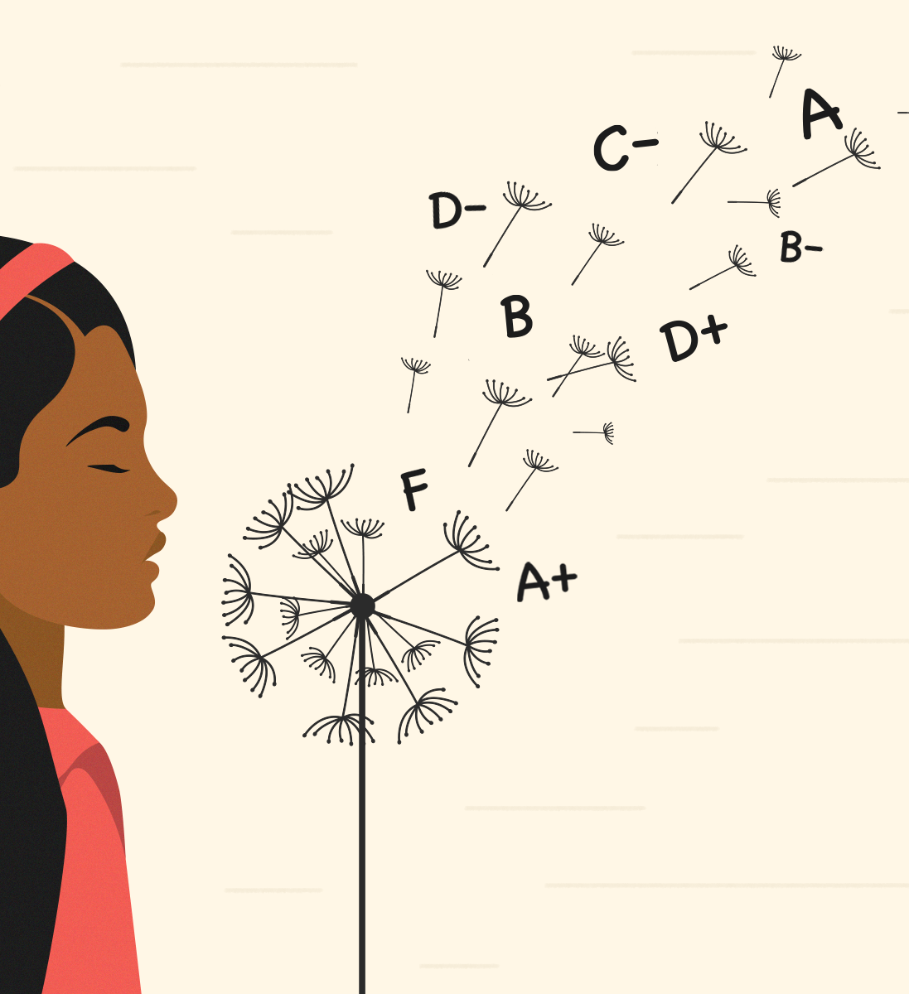
Grading and Assessing
Last piece of the puzzle
It weaves it all together
Students pay attention
This part is more personal…
Notes:
You can show whichever mindset and set the policies you want, ultimately, students pay attention to your grading and assessment of their work
You need to make sure that your grading follows your philosophy, what you share in your communication with your students, but also what you have set as policies in your syllabus

Slide 24
A detour to the shaping of my philosophy
Open access: students come with different levels of preparedness; different constraints and circumstances; different identities; differences but strengths
Access without equity and inclusion is a missed opportunity
What do I grade?
Ultimately, do students fail who were equipped to pass? And vice versa?
Should students’ grade reflect their learning pace? Their ability to stay on track?
Errors are praised as necessary in learning

Slide 25
Central element of my philosophy
With impact on my grading
Failure IS an option
Notes:
Let me share more about my research and experience on failure, and challenge you all to think about what that could mean in your classrooms

Slide 26
What do people say about Failure?
“Failure is success in progress.” - Albert Einstein
"If you are not confused, you are not paying attention", by Tom Peters
[In real life] "nobody scores you on a failure provided you end up on a success", Jeff Olson, President of Hiller Measurements
normalizing Failure and struggle?
→ mindset
Notes:
So what do we know about failure? How do we experience it?
Here, we have a few important quotes. It’s about process, what you do after or with a failure.
But in a more mundane manner:
How about learning to eat with a spoon? We’re just not good at it? Do we give up?
Roger Federer’s comments about winning 80% but roughly 50% of points → what does that mean?
We talked about normalizing struggle, I say, let’s normalize failure too, but it should not just be lip service

Slide 27
So, How to address failure?
Failure happens, it’s unescapable, it is desirable
Not an issue BUT part of the learning process
→ Not to be fixed
We embrace it!
Notes:
Now, accepting that failure is not an option: it WILL happen
It SHOULD happen (more on that later)
What do we do with it?
ENCOURAGE IT, drop the fear, tame the failure
It is to be tamed: drop the fear AND make something of it

Slide 28
What does failure look like? And what to do about it?
[2 minutes] Think of a type of failure your students can face and how you could guide them to improve
[5-10 minutes] Share your thoughts and ideas about addressing failure with your neighbor(s) or at your table
[5-7 minutes] Report to the whole group (voluntary)
Notes:
Let me turn to you and ask you to think about what failure means for you, for each of your disciplines
What does it look like, and what can you do about it?
What to do: support, feedback, what else?

Slide 29
The power of embracing failure
It gets you started
It puts you on the path to succeeding
It reinforces your learning
Notes:
Leon Marchand

Slide 30
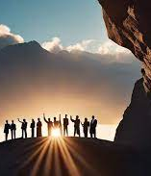
the good in failure
Mathematician David Bessis urges the development of mental models, even if incorrect, as a starting point → we need them to build correct ones over time
He further stresses the need to be comfortable with being wrong to enhance learning
Study about math achievements in Japan VS the US
55% VS 10% struggle
Mathematica, une aventure au coeur de nous-mêmes, D. Bessis
Notes:
So earlier, we were brainstorming about what to do with failure. The first thing to do it to encourage it, to lower our students’ inhibition with errors. Otherwise, they get stuck and do not embark on the learning journey. An incorrect mental model is better than none.
We’ll see later that an incorrect one is possibly better than a correct one, to start with.
Additionally, or to reinforce what we just said, being afraid is detrimental to learning (we are stuck). Earlier, we talked about dropping the fear of failure. This is backed by science

Slide 31
Emotions: a catalyzer for learning from errors
Learning is enhanced when students:
First form answers – engaged
Are surprised by the actual answer – emotion, fun
Action, trial & error, emotion (surprise, fun)
= learning
BUT: Students must be willing to play
L’école du cerveau, de Montessori, Freinet et Piaget aux sciences cognitives, O. Houdé
Notes:
Here we push it further and see that creating situations (what I call traps with my students, in a playful manner) will contribute to reinforced learning.
Engaging
Having emotions
Being surprised and correcting our errors
BUT for this we need no fear, we need students who are willing to play

Slide 32
The elephant in the room

Slide 33
Can/should we always fail?
And what is failure?

Slide 34
How about really important situations?
Teaching surgeons, nurses, etc.
Teaching your child how to drive
Others?
Is this the case of what you teach? Share with the whole group
Notes:
It’s about scaffolding, planning, to build mastery, but with the need to develop problem-solving skills
You need surgeons to know how to react to stress
You need your child to know how to react to bad weather (snow day), bad drivers, etc.
So the training has to be providing these sore points
Performance should not, cannot be perfect, but perfection should be the aim on the longer run

Slide 35
Let’s regroup
Failure is good for learning
We don’t mean for failure to be final, but rather developmental
However…

Slide 36
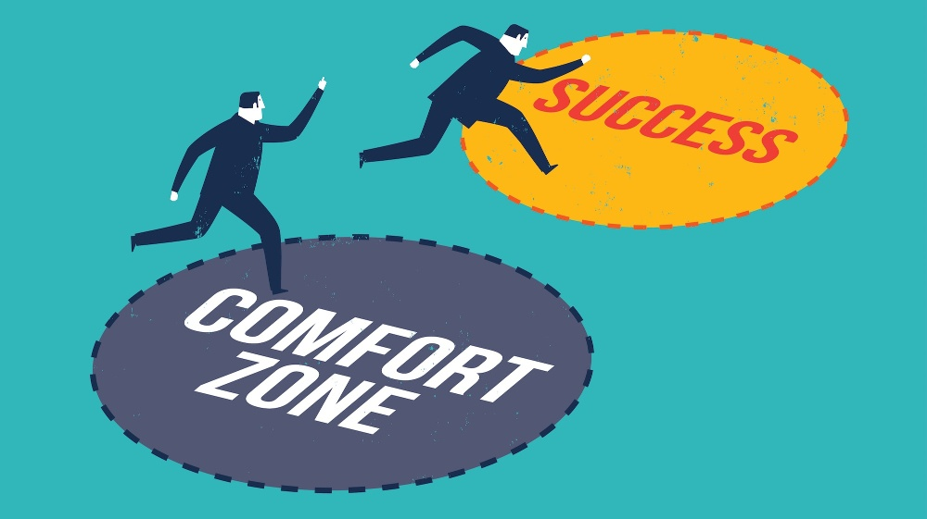
What does it take for students not to be afraid and play along?

Slide 37
Safety
Fear of failing → detrimental to memorization and to learning
Instead: Safe environment, psychological safety: including failure-safe, identity-safe
Normalizing failure and struggle
Celebrating differences, asset-based & growth mindset
→ Reconciling students with learning and the joy of learning, a playground
→ Dropping the “fear to start”
The Psychological Safety Playbook: Lead More Powerfully by Being More Human Lead More Powerfully by Being More Human, Helbig & Norman // The Fearless Organization: Creating Psychological Safety in the Workplace for Learning, Innovation, and Growth, Edmondson // Neuroscience: the Highs and Lows of Memory, Allen & Monyer, 2013
Notes:
This brings me to talk about safety.
This is all interconnected and we could take any of these topics (fear, safety, and later equity) and address them in any order as they reinforce each other
Reinforcing in class our philosophy about creating a safe environment where everyone is welcome, every identity and background, including academic background, that we are there to work together.
NORMALIZING FAILURE AND STRUGGLE
Recognizing “failure” as a step in the right direction, not a wrong direction to be corrected, most of the times
I compare my class and the semester to a playground: this is our safe place, to practice, learn, grow, at our own pace, with our own style.
Interestingly about when students are willing to play and are engaged, a study by Houdé showed that the brain waves (the cerebral activity) of teacher and students are in synch.

Slide 38
The good about Safety
An interesting result!!!
When students are engaged & feel safe
Brain waves of professor /students: are in synch
And learning takes place

Slide 39
What else is necessary for truly embracing failure?

Slide 40
True safety about failing
It should not affect grades (at least to a point – failure is not meant to be final)
→ Grading for mastery instead of journey
→ Leveling the playing field
Inclusion, Inc., Sanford S. // Inclusalytics: How Diversity, Equity, and Inclusion Leaders use Data to Drive their Work, Mattingly, V., Grice, S., Goldstein, A. // Grading for Equity, Feldman, J. // On Your Mark, Guskey, T.

Slide 41
Let’s talk about risks/challenges

Slide 42
What risks do you foresee in embracing failure in your classroom?
[2 minutes] Think of a risk (risks) that embracing / encouraging failure could pose to your students’ success. What could be the negative impact for your students’ learning?
[5-10 minutes] Share what this risk is with your neighbor(s) or at your table.
[5-7 minutes] Report to the whole group (voluntary).

Slide 43
Lessons learned
Students will delay working: no urgency to perform when there are a lot of conflicting commitments
Students will be confused about their standing in the class
Difficulty convincing students to think differently about grading
Notes:
The major hurdles I faced were the following.
And then, some students were in disbelief
not work (study habits are also part of what they learn, why not apply the same philosophy about it?)

Slide 44
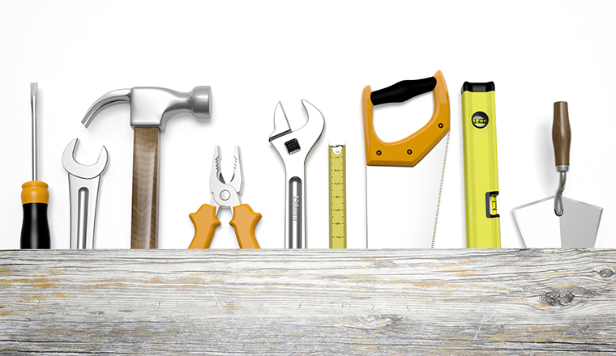
Strategies & tools to mitigate risks
Notes:
So, how do we mitigate these risks?
Instilling a healthy study habit is essential to the learning
Communicating about the standing is essential for the safety

Slide 45
Let’s brainstorm about mitigating risks
[2 minutes] Focus on a risk you discussed in your group. Now think of a way you could mitigate this risk: what could you do to avoid this pitfall or minimize its potential negative impact?
[5-10 minutes] Share your strategy with your neighbor(s).
[5-7 minutes] Report to the whole group (voluntary)

Slide 46
policies
Engage students in their learning, consistently (no delays):
Expectation of focus on learning and engagement with the material → grading policy = extra dimension (engagement, preparedness)
E.g., labs are not graded, preparedness is, indicators of engagement
Revisiting policies for equity: e.g., attendance
Clear communication of standing in class:
Traditional grading weighted sum in syllabus → reference for lower bound
Notes:
Insist on:
policy: it depends on the class
Grading: discuss different approaches and my own failures
Attendance: not to penalize but to help

Slide 47
Service to students
Assessment consistent with philosophy:
Outcomes driving the grading → mastery levels
Grading often, with meaningful feedback
Clear philosophy, reassurance we are on the same page:
Adopting a growth mindset vocabulary → making it visible and grounded in reality
Frequent communication of encouragement
Notes:
Insist on:
policy: it depends on the class
Grading: discuss different approaches and my own failures
→ as students embark on the learning journey, it is important that they experience the material, they “test themselves”

Slide 48
Tools/ways to help make this happen
Pretty lightweight once you get your communication clear (and the word of mouth goes around)
Clear outcomes → to guide the journey + a grading system that works for you
Some grading help: for me, Gradescope for it ease of grading & feedback (fast and meaningful)
Student-oriented team: trained to be positive, constructive, caring, and supportive of students (surprise them with positivity)
Communicate, communicate, communicate: in class, outside class (encouraging messages), blog
Notes:
Clear outcomes → to guide the journey → also for students
Gradescope: not multiple-choice questions, but ease of grading + feedback (fast and meaningful) AND I DO IT, I SEE IT
Communicate, communicate, communicate: in class, outside class (encouraging messages), blog
Availability

Slide 49
So how well does it work? Students’ paths
Students push through → fewer drops
They understand that what’s behind them is behind them (like Roger Federer says of his tennis points ☺)
Students who would have failed under a traditional grading system now pass the class (about 80% of those who would have failed pass)
And go on to be successful in the subsequent courses

Slide 50
What do students say about it?
rather than feeling discouraged from a failing grade, her grading technique gave me a sense of “Okay, I did good in these questions, and I need to keep practicing in these other areas I didn’t do so well in, so now I know what areas to target” all without making me feel like I’m not smart enough
It made it feel like failure is a natural part of learning and failure helped me to improve and ultimately got an A in the class
Failure was not a big deal for sure.
I can stress less about it and focus on next topics instead of just feeling bad and wanting to give up.
If I got a bad grade I said to myself "Ok I need to do better" so I looked back at what I messed up on and practiced it until I improved.
She’s the main reason I wasn’t
afraid of struggling because she
was always there when i needed her.
I felt less stress and less test anxiety

Slide 51
What we have not talked about
The ever-changing landscape:
Students change
Discipline and technology change
Most recent change: Artificial Intelligence
It’s broad access and generative capabilities
How does this impact what we covered today?

Slide 52
Today’s topics in the light of AI
Mindset:
Urgent to convince students “they can do it” and do not need AI to think for themselves
So, let’s show them what AI is good for (and what it’s not good for)
Policies:
We need to be clear about what constitutes “legal” use of AI
This is important for us, but also for the psychological safety of our students
Grading:
There are battles we may not want to take on
Change the types of assignments, what is graded / not graded

Slide 53
How about helping instructors?
Grading tools:
E.g., Gradescope
AI Assistants
Assignments catered to using AI in a way that forces students to be proactive about improving
Control/enforce the conversation script
Model what / how students can use AI
Design assignments that show the (current) limitations of AI (to diminish blind trust in gen. AI)

Slide 54
Any other uses of AI? Limitations due to AI?

Slide 55
That’s it for today
Strategies for students’ success in:
Teaching mindset
Policies
Grading and Assessment
with a specific example of how to embrace failure about how it brings all elements together
Changes due to AI: good and not as good

Slide 56
What’s your takeaway?

Slide 57
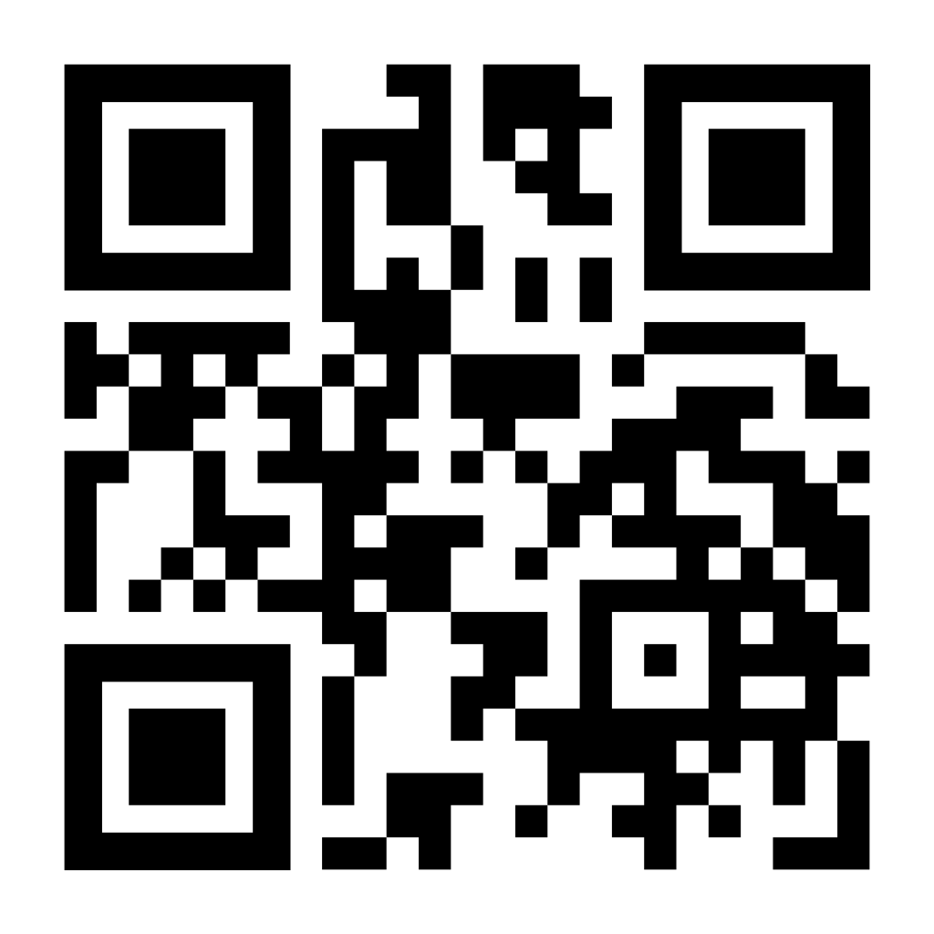
Interested in Continuing the conversation?
Contact me at: mceberio@utep.edu // http://www.martineceberio.fr
Notes:
[3 minutes]

Slide 58
Thank you for your attention!
Happy to take any question ☺
Contact me at: mceberio@utep.edu
// http://www.martineceberio.fr

Slide 59
Some references
Allen, K., Monyer, H. The highs and lows of memory. Nature 504, 228–229 (2013). https://doi.org/10.1038/504228a
D. Bessis, “Mathematica, une aventure au coeur de nous-mêmes,” Editions du Seuil.
Canning, E. A., Ozier, E., Williams, H. E., AlRasheed, R., & Murphy, M. C. (2022). Professors Who Signal a Fixed Mindset About Ability Undermine Women’s Performance in STEM. Social Psychological and Personality Science, 13(5), 927-937. https://doi.org/10.1177/19485506211030398
Elizabeth A. Canning, Katherine Muenks, Dorainne J. Green and Mary C. Murphy. “STEM faculty who believe ability is fixed have larger racial achievement gaps and inspire less student motivation in their classes.” In Science Advances, vol. 5, issue 2. 2019. eISSN2375-2548. Publisher: American Association for the Advancement of Science
Min Derry, University of Pennsylvania. “Reflection: The Necessity of Failure.” https://weingartencenter.universitylife.upenn.edu/bigger-pictures-the-necessity-of-failure/
Dong Anmei , Jong Morris Siu-Yung , King Ronnel B. “How Does Prior Knowledge Influence Learning Engagement? The Mediating Roles of Cognitive Load and Help-Seeking”. Frontiers in Psychology, vol. 11, 2020, https://www.frontiersin.org/journals/psychology/articles/10.3389/fpsyg.2020.591203. DOI=10.3389/fpsyg.2020.591203
A.C. Edmonson, “The Fearless Organization: Creating Psychological Safety in the Workplace for Learning, Innovation, and Growth”, Eds Wiley, 2018
Feldman, J. “Grading for Equity”, 2023

Slide 60
Some more references
Flint, A. S., & Jaggers, W. (2021). You matter here: The impact of asset-based pedagogies on learning. Theory Into Practice, 60(3), 254–264. https://doi.org/10.1080/00405841.2021.1911483
Guskey, T. “On Your Mark”, 2014
Helbig and Norman, “The Psychological Safety Playbook: Lead More Powerfully by Being More Human”
O. Houdé, “L’école du cerveau, de Montessori, Freinet et Piaget aux sciences cognitives,”Editions Mardaga
Mattingly, V., Grice, S., Goldstein, A. “Inclusalytics: How Diversity, Equity, and Inclusion Leaders use Data to Drive their Work”, 2022
Mein, Erika L.. “Asset-Based Teaching and Learning with Diverse Learners in Postsecondary Settings.” (2018).
S. Sanford, “Inclusion, Inc.: How to Design Intersectional Equity into the Workplace”, 2022
Student Experience Project, https://studentexperienceproject.org

Slide 61
Failure in the classroom
Necessary
Proven by science that it is better
BUT: how do we allow students to fail and take it seriously?
If it is not graded, there is little incentive and then we are back into a system where they fail and there is little opportunity to improve
If it is graded, then we need not to systematically include the bad grade in the final grade, otherwise, it is hypocritical

Slide 62
Exercise not graded in which a student gives the wrong answer, but then it is corrected and now they understand it better (it can be a surprise situation).
Showing them that they can improve and use this to convince them they can improve even after a bad grade

