Slide 1
Celebrating Failure as Part of Learning
Towards More Learning and Equity in the Classroom
Martine Ceberio
Computer Science Professor
Associate Dean of Engineering for People, Culture, and Environment
The University of Texas at El Paso
mceberio@utep.edu

Slide 2
Welcome!
Today’s goals:
Learning about the power of failure
Discussing risks of integrating failure as a tool to teach and for students to learn
Considering tools and strategies to mitigate risks
Instilling interest in continuing this conversation beyond this afternoon
UT El Paso – border of Mexico, 24,000 students,
84% Hispanic in UG population, open institution
Notes:
Welcome to this talk.
Before to proceed, let me tell you a little bit about where I come from. UTEP…
Now, what are we going to do together today?
Go over the goals of this talk.

Slide 3
What about Failure?
“Failure is success in progress.” - Albert Einstein
"If you are not confused, you are not paying attention", by Tom Peters
[In real life] "nobody scores you on a failure provided you end up on a success", Jeff Olson, President of Hiller Measurements
normalizing Failure and struggle?
Notes:
So what do we know about failure? How do we experience it?
Here, we have a few important quotes. It’s about process, what you do after or with a failure.
But in a more mundane manner:
How about learning to eat with a spoon? We’re just not good at it? Do we give up?
Roger Federer’s comments about winning 80% but roughly 50% of points → what does that mean?

Slide 4
So, what do we do with failure?
Failure happens, it’s unescapable, it is desirable
It is not an issue BUT part of the process
→ It is not to be fixed (as in: getting rid of it)
It is to be tamed: drop the fear AND make something of it
Notes:
Now, accepting that failure is not an option: it WILL happen
It SHOULD happen (more on that later)
What do we do with it?
ENCOURAGE IT, drop the fear, tame the failure

Slide 5
What does failure look like? And what to do about it?
[2 minutes] Think of a type of failure your students can face and how you could guide them to improve
[5 minutes] Share your thoughts and ideas about addressing failure with your neighbor(s)
[5 minutes] Report to the whole group (voluntary)
Notes:
Let me turn to you and ask you to think about what failure means for you, for each of your disciplines
What does it look like, and what can you do about it?
What to do: support, feedback, what else?

Slide 6
embracing the good in failure
Mathematician David Bessis prones the development of mental models, even if incorrect, as a starting point → we need them to build correct ones over time
He further stresses the value in learning to be comfortable with being wrong.
Afraid of failing → detrimental to memorization and to learning
Mathematica, une aventure au coeur de nous-mêmes, D. Bessis // Neuroscience: the Highs and Lows of Memory, Allen & Monyer, 2013
Notes:
So earlier, we were brainstorming about what to do with failure. The first thing to do it to encourage it, to lower our students’ inhibition with errors. Otherwise, they get stuck and do not embark on the learning journey. An incorrect mental model is better than none.
We’ll see later that an incorrect one is possibly better than a correct one, to start with.
Additionally, or to reinforce what we just said, being afraid is detrimental to learning (we are stuck). Earlier, we talked about dropping the fear of failure. This is backed by science

Slide 7
Dropping the fear of failure Welcoming surprises
Learning is enhanced when students:
First form answers – engaged
Are surprised by the actual answer – emotion, fun
Action, trial and error, emotion (surprise, fun) = learning
BUT: Students must be willing to play
L’école du cerveau, de Montessori, Freinet et Piaget aux sciences cognitives, O. Houdé
Notes:
Here we push it further and see that creating situations (what I call traps with my students, in a playful manner) will contribute to reinforced learning.
Engaging
Having emotions
Being surprised and correcting our errors
BUT for this we need no fear, we need students who are willing to play

Slide 8
Safety for more Learning
Safe environment, psychological safety: including failure-safe, identity-safe
Normalizing failure and struggle
Brain waves professor/students: synchronous when students are engaged & feel safe
Reconciling students with learning and the joy of learning, a playground
The Psychological Safety Playbook: Lead More Powerfully by Being More Human Lead More Powerfully by Being More Human, Helbig & Norman // The Fearless Organization: Creating Psychological Safety in the Workplace for Learning, Innovation, and Growth, Edmondson
Notes:
This brings me to talk about safety.
This is all interconnected and we could take any of these topics (fear, safety, and later equity) and address them in any order as they reinforce each other
Reinforcing in class our philosophy about creating a safe environment where everyone is welcome, every identity and background, including academic background, that we are there to work together.
NORMALIZING FAILURE AND STRUGGLE
Recognizing “failure” as a step in the right direction, not a wrong direction to be corrected, most of the times
I compare my class and the semester to a playground: this is our safe place, to practice, learn, grow, at our own pace, with our own style.
Interestingly about when students are willing to play and are engaged, a study by Houdé showed that the brain waves (the cerebral activity) of teacher and students are in synch.

Slide 9
Embracing failure, Creating a safe place, & enhancing Equity in your classroom
Some context about UTEP
Our philosophy is: access BUT access without inclusion and equity is useless
Grading should not penalize the learning process or the student’s situation
Leveling the playing field
Mastery instead of journey
Inclusion, Inc., Sanford S. // Inclusalytics: How Diversity, Equity, and Inclusion Leaders use Data to Drive their Work, Mattingly, V., Grice, S., Goldstein, A. // Grading for Equity, Feldman, J. // On Your Mark, Guskey, T.

Slide 10
Let’s talk about risks/challenges

Slide 11
What risks do you foresee in embracing failure in your classroom?
[2 minutes] Think of a risk (risks) that embracing / encouraging failure could pose to your students’ success. What could be the negative impact for your students’ learning?
[5 minutes] Share what this risk is with your neighbor(s).
[5 minutes] Report to the whole group (voluntary).

Slide 12
Lessons learned
Students will delay working: no urgency to perform and a lot of conflicting commitments
Students will be confused about their standing in the class
Difficulty convincing students to think differently about grading
Notes:
The major hurdles I faced were the following.
And then, some students were in disbelief
not work (study habits are also part of what they learn, why not apply the same philosophy about it?)

Slide 13
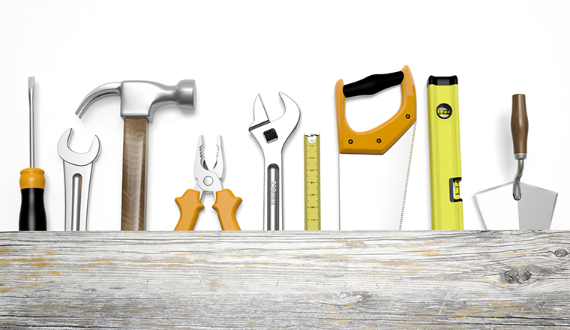
Strategies & tools to mitigate risks
Notes:
So, how do we mitigate these risks?
Instilling a healthy study habit is essential to the learning
Communicating about the standing is essential for the safety

Slide 14
Let’s brainstorm about mitigating risks
[2 minutes] Focus on a risk you discussed in your group. Now think of a way you could mitigate this risk: what could you do to avoid this pitfall or minimize its potential negative impact?
[5 minutes] Share your strategy with your neighbor(s).
[5 minutes] Report to the whole group (voluntary)

Slide 15
approaches to mitigating risks -- policies
Engage students in their learning, consistently (no delays):
Expectation of focus on learning and engagement with the material → policy
E.g., labs are not graded, preparedness is, indicators of engagement
Revisiting policies for equity (e.g., attendance)
Clear communication of standing in class:
Traditional grading weighted sum in syllabus → reference for lower bound
Notes:
Insist on:
policy: it depends on the class
Grading: discuss different approaches and my own failures
Attendance: not to penalize but to help

Slide 16
approaches to mitigating risks -- service
Assessment consistent with philosophy:
Outcomes driving the grading → mastery levels
Grading often, with meaningful feedback
Clear philosophy, reassurance we are on the same page:
Adopting a growth mindset vocabulary → making it visible
Frequent communication of encouragement
Notes:
Insist on:
policy: it depends on the class
Grading: discuss different approaches and my own failures
→ as students embark on the learning journey, it is important that they experience the material, they “test themselves”

Slide 17
Tools/ways to help make this happen
Pretty lightweight once you get your communication clear (and the word of mouth goes around)
Clear outcomes → to guide the journey + a grading system that works for you
Some grading help: for me, Gradescope for it ease of grading & feedback (fast and meaningful)
Student-oriented team: trained to be positive, constructive, caring, and supportive of students (surprise them with positivity)
Communicate, communicate, communicate: in class, outside class (encouraging messages), blog
Availability
Notes:
Clear outcomes → to guide the journey → also for students
Gradescope: not multiple-choice questions, but ease of grading + feedback (fast and meaningful) AND I DO IT, I SEE IT
Communicate, communicate, communicate: in class, outside class (encouraging messages), blog
Availability

Slide 18
So how well does it work? Students’ paths
Students push through → fewer drops
They understand that what’s behind them is behind them (like Roger Federer says of his tennis points ☺)
Students who would have failed under a traditional grading system now pass the class (about 80% of those who would have failed pass)
And go on to be successful in the subsequent courses

Slide 19
What do students say about it?
She’s the main reason I wasn’t afraid of struggling because she was always there when i needed her.
Failure was not a big deal for sure.
I did not feel discouraged due to a bad grade and it helped me to improve. If I got a bad grade I said to myself "Ok I need to do better" so I looked back at what I messed up on and practiced it until I improved.
it made it feel like failure is a natural part of learning and failure helped me to improve and ultimately got an A in the class
I felt less stress and less test anxiety
Failing a test usually discourages me, but rather than feeling discouraged from a failing grade, her grading technique gave me a sense of “Okay, I did good in these questions, and I need to keep practicing in these other areas I didn’t do so well in, so now I know what areas to target” all without making me feel like I’m not smart enough.
Overall I really liked the technique and philosophy behind tests that are used to see where you currently stand and be aware of what needs improvement and be encouraged to keep practicing to do better rather than looking at tests with fear of potential failure.
I I can
I can stress less about it and focus on next topics instead of just feeling bad and wanting to give up.
Notes:
I did not feel discouraged due to a bad grade and it helped me to improve. If I got a bad grade I said to myself "Ok I need to do better" so I looked back at what I messed up on and practiced it until I improved.
I felt less stress and less test anxiety

Slide 20
What do students say about it?
rather than feeling discouraged from a failing grade, her grading technique gave me a sense of “Okay, I did good in these questions, and I need to keep practicing in these other areas I didn’t do so well in, so now I know what areas to target” all without making me feel like I’m not smart enough
It made it feel like failure is a natural part of learning and failure helped me to improve and ultimately got an A in the class
Failure was not a big deal for sure.
I can stress less about it and focus on next topics instead of just feeling bad and wanting to give up.
If I got a bad grade I said to myself "Ok I need to do better" so I looked back at what I messed up on and practiced it until I improved.
She’s the main reason I wasn’t
afraid of struggling because she
was always there when i needed her.
I felt less stress and less test anxiety

Slide 21
What’s your takeaway?

Slide 22
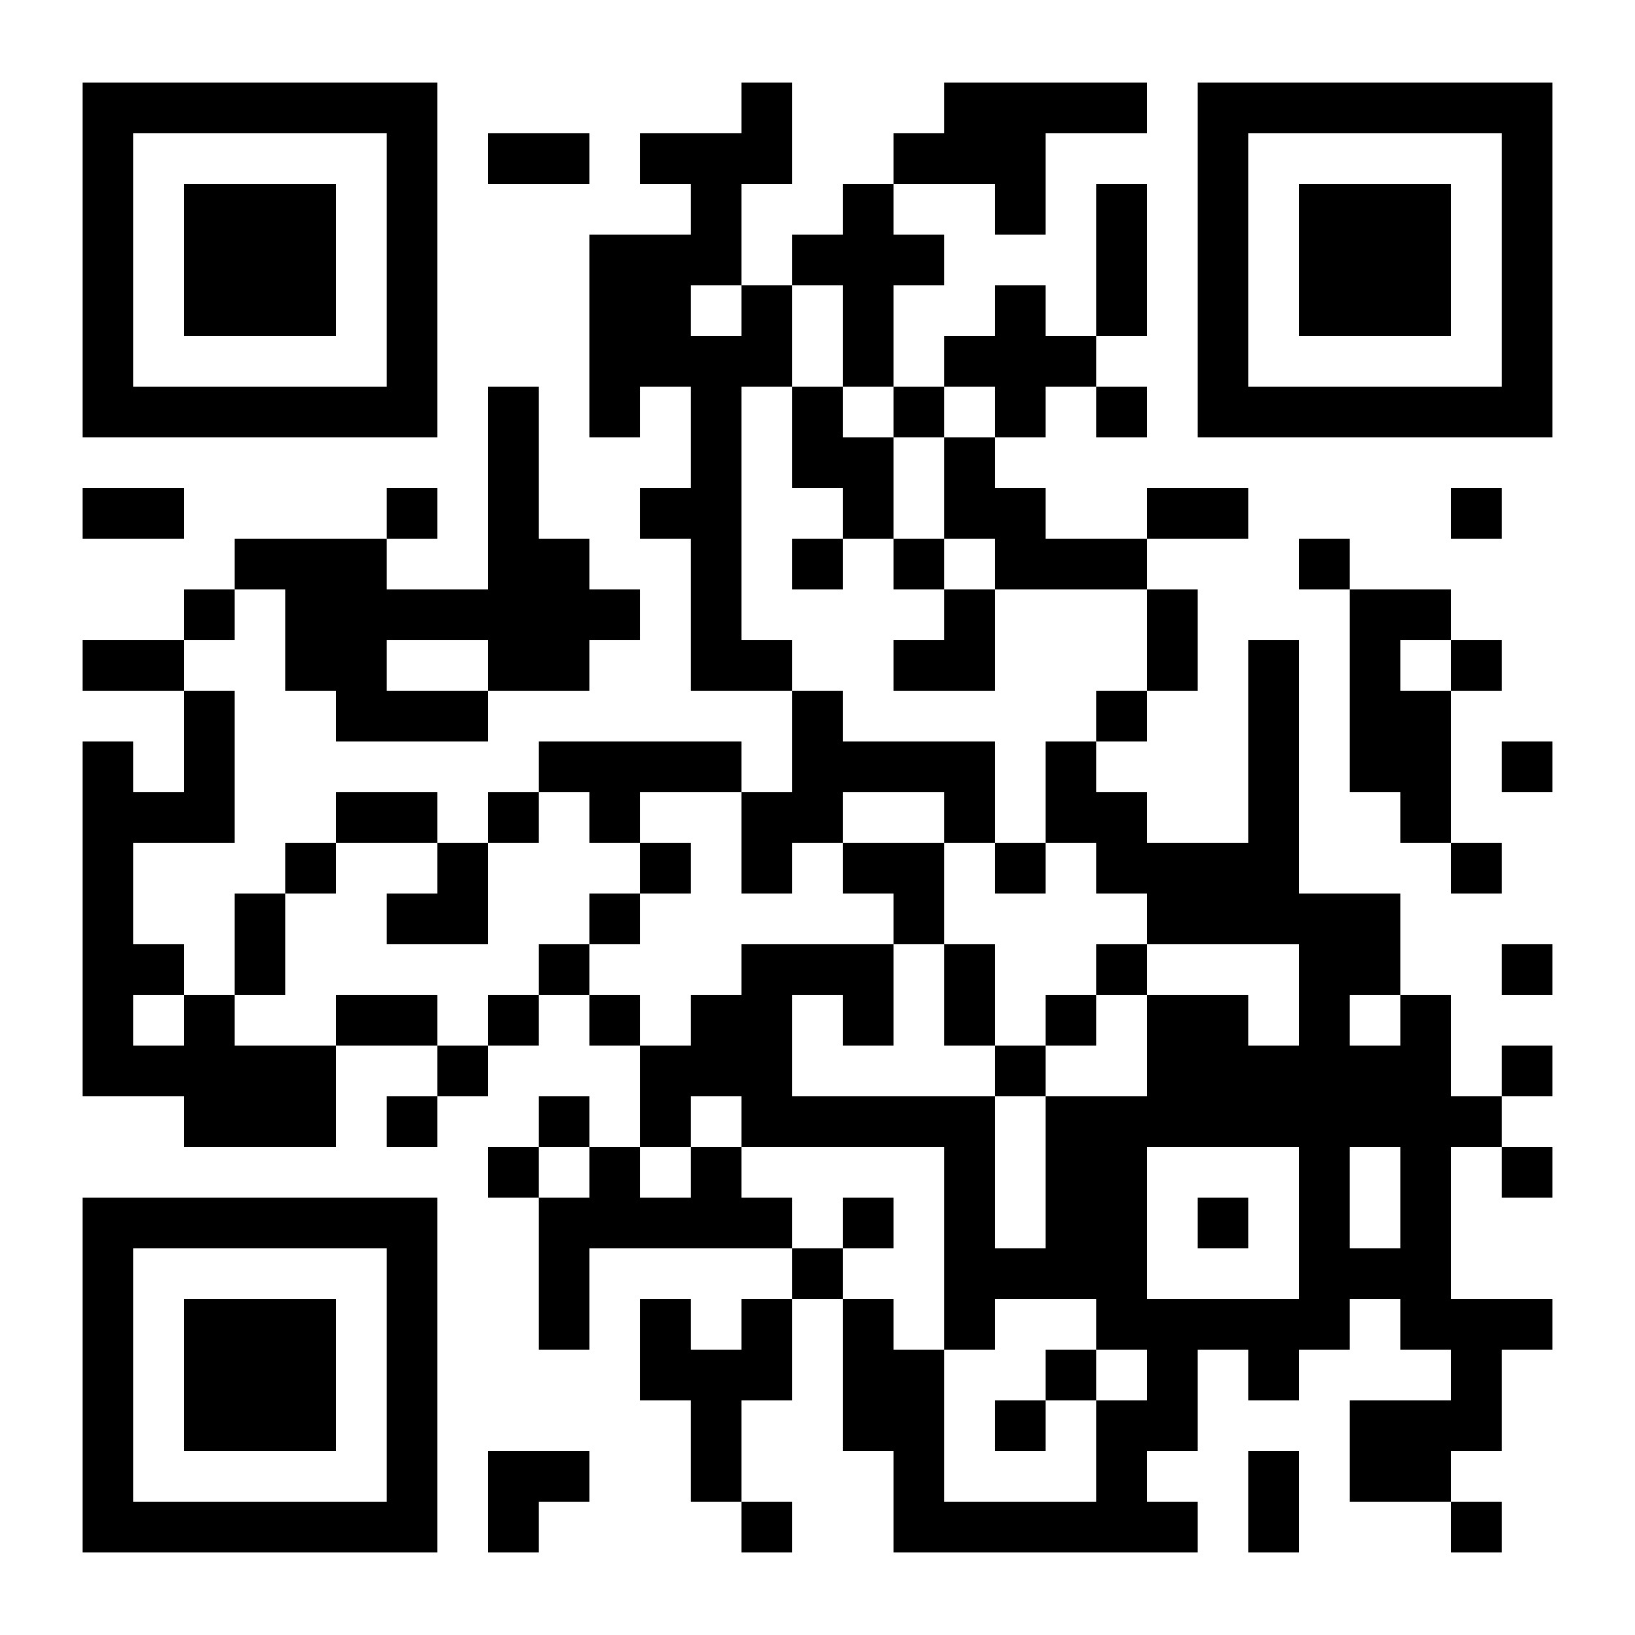
SIg? CoP? On Failure as a tool to enhance learning?
Failure-safe learning environment
https://forms.gle/H3qLxo8tgPFNzWs68
Contact me at: mceberio@utep.edu // http://www.martineceberio.fr
Notes:
[3 minutes]

Slide 23
Thank you for your attention!
Happy to take any question ☺
Contact me at: mceberio@utep.edu
// http://www.martineceberio.fr

