Slide 1


Slide 2
Computer Science @ UTEP
Dr. Martine Ceberio
Professor of Computer Science
February 2023

Slide 3
BUT WHAT IS COMPUTER SCIENCE?
Has anyone done Computer Science before?
Does anyone know what Computer Science is?
Do you have any interest in Computer Science for your future career?

Slide 4
LET’s TAKE A LOOK…
https://www.youtube.com/watch?v=QvyTEx1wyOY

Slide 5
So what is Computer Science?
A lot of team work
Little time in front of the computer
Most time spent:
  Solving problems: you are not using, you are building
    E.g., video games, phone apps, virtual reality products
  Innovating! Defining new problems, new products
  Interacting with a team
  And very importantly… You can do all you want: no need for expensive “stuff” ☺
  At your age, you can go ahead and design your website, your app, software to help people… you name it!
Your imagination is the limit!!!

Slide 6
Who are Computer Scientists?
The face of technology is changing…
  And needs to change (automated answering systems, cars, etc.)
  Diversity is key!
We need women in CS because
  1/ WHY NOT???
  2/ Otherwise, they do not get to pick the problems to be solved…
  3/ Because these are high-paying jobs that go to only men instead

Slide 7
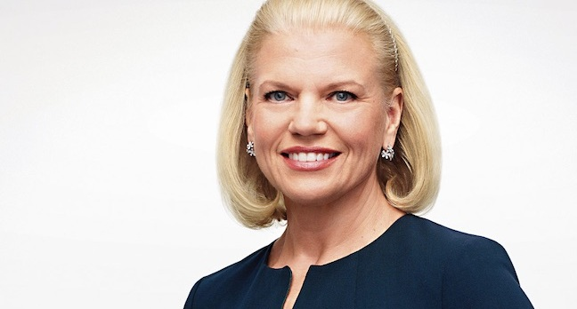
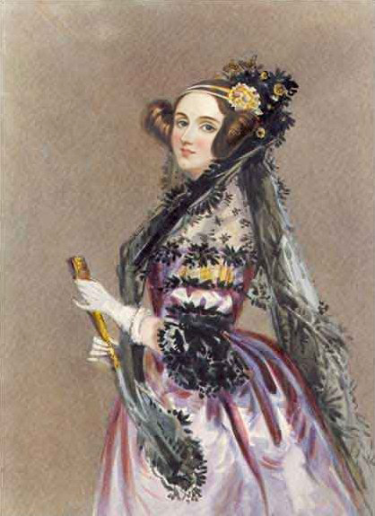
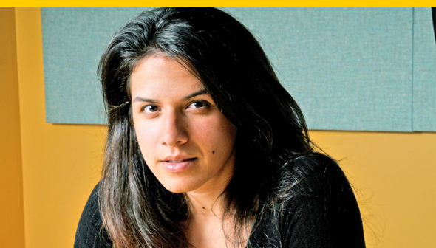

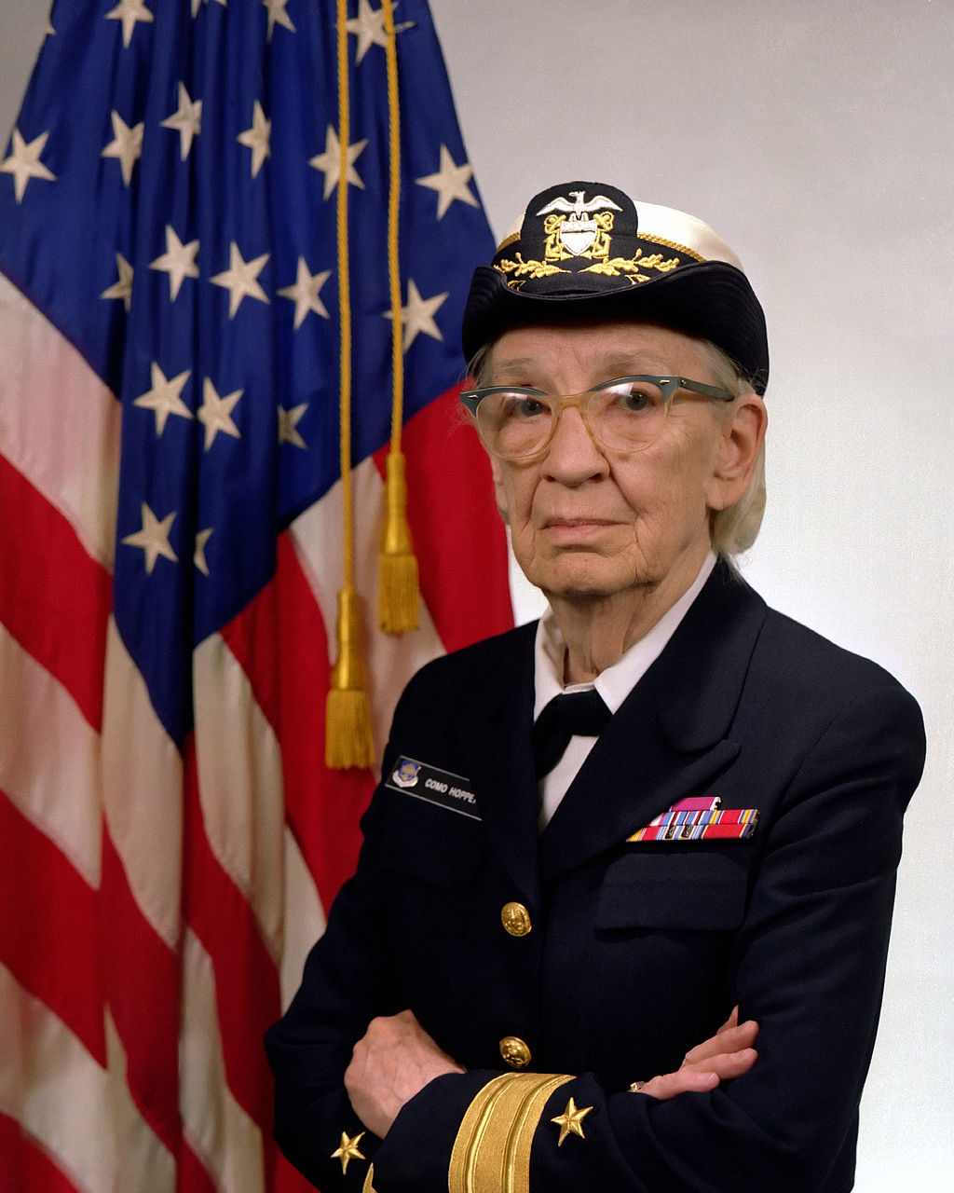
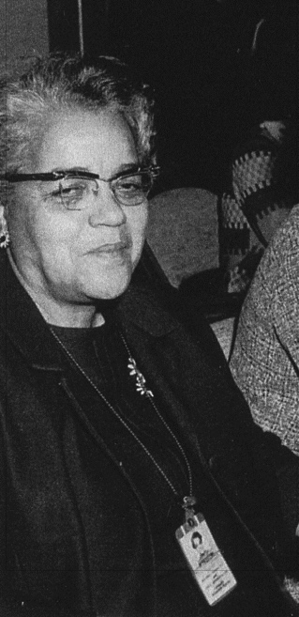
Women in CS…
We need men and women to design the great tools of the future
Notes:
Iranian-Polish-American computer security expert who works for Google as an information security manager and "Security Princess"

Slide 8
Women in CS
https://www.youtube.com/watch?v=mFPg96gdPkc&t=2s
Notes:
2:33

Slide 9
Technology of the future…
It is yours to define! All of you!!
So what will it be???
Notes:
Iranian-Polish-American computer security expert who works for Google as an information security manager and "Security Princess"

Slide 10
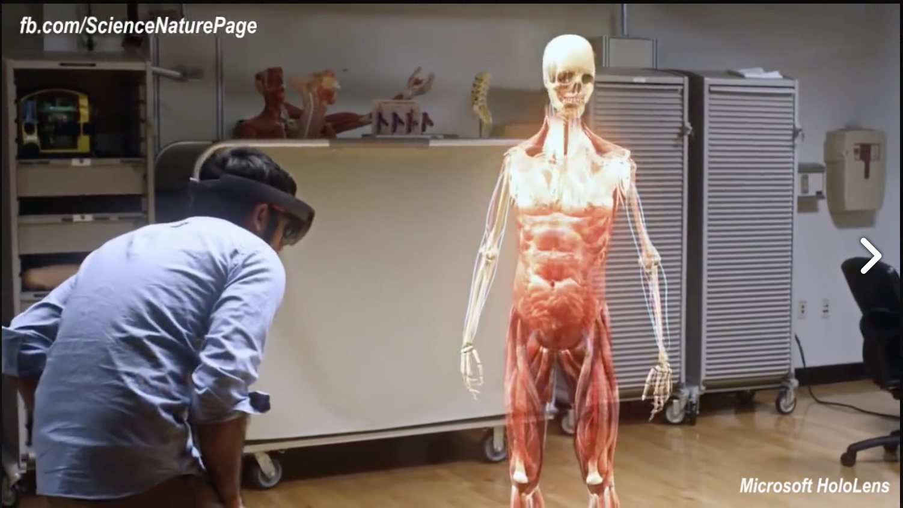
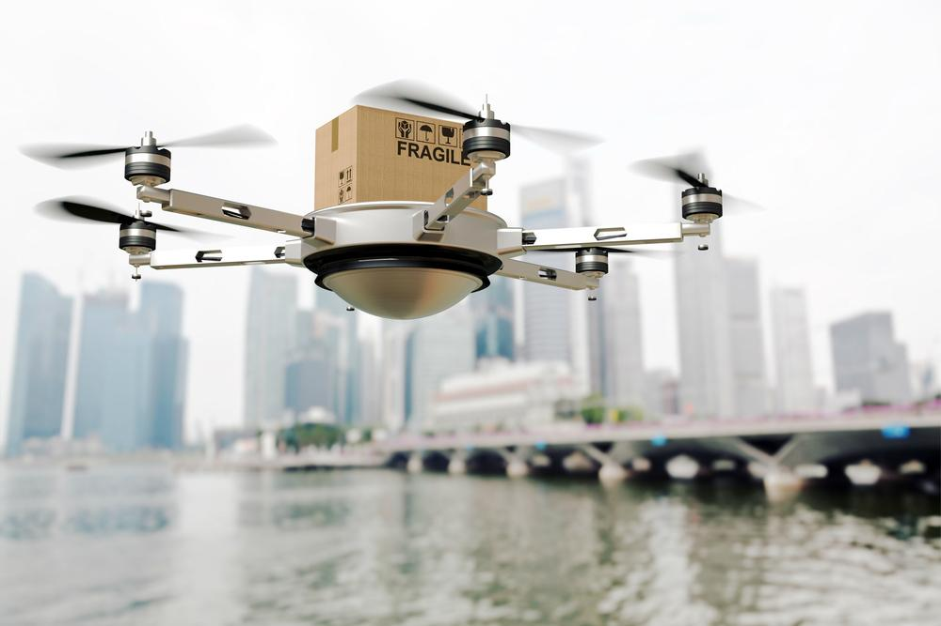
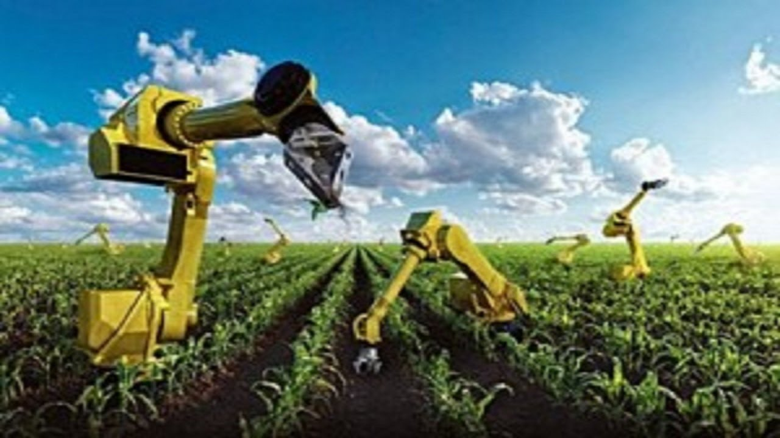


Slide 11
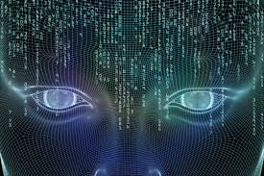
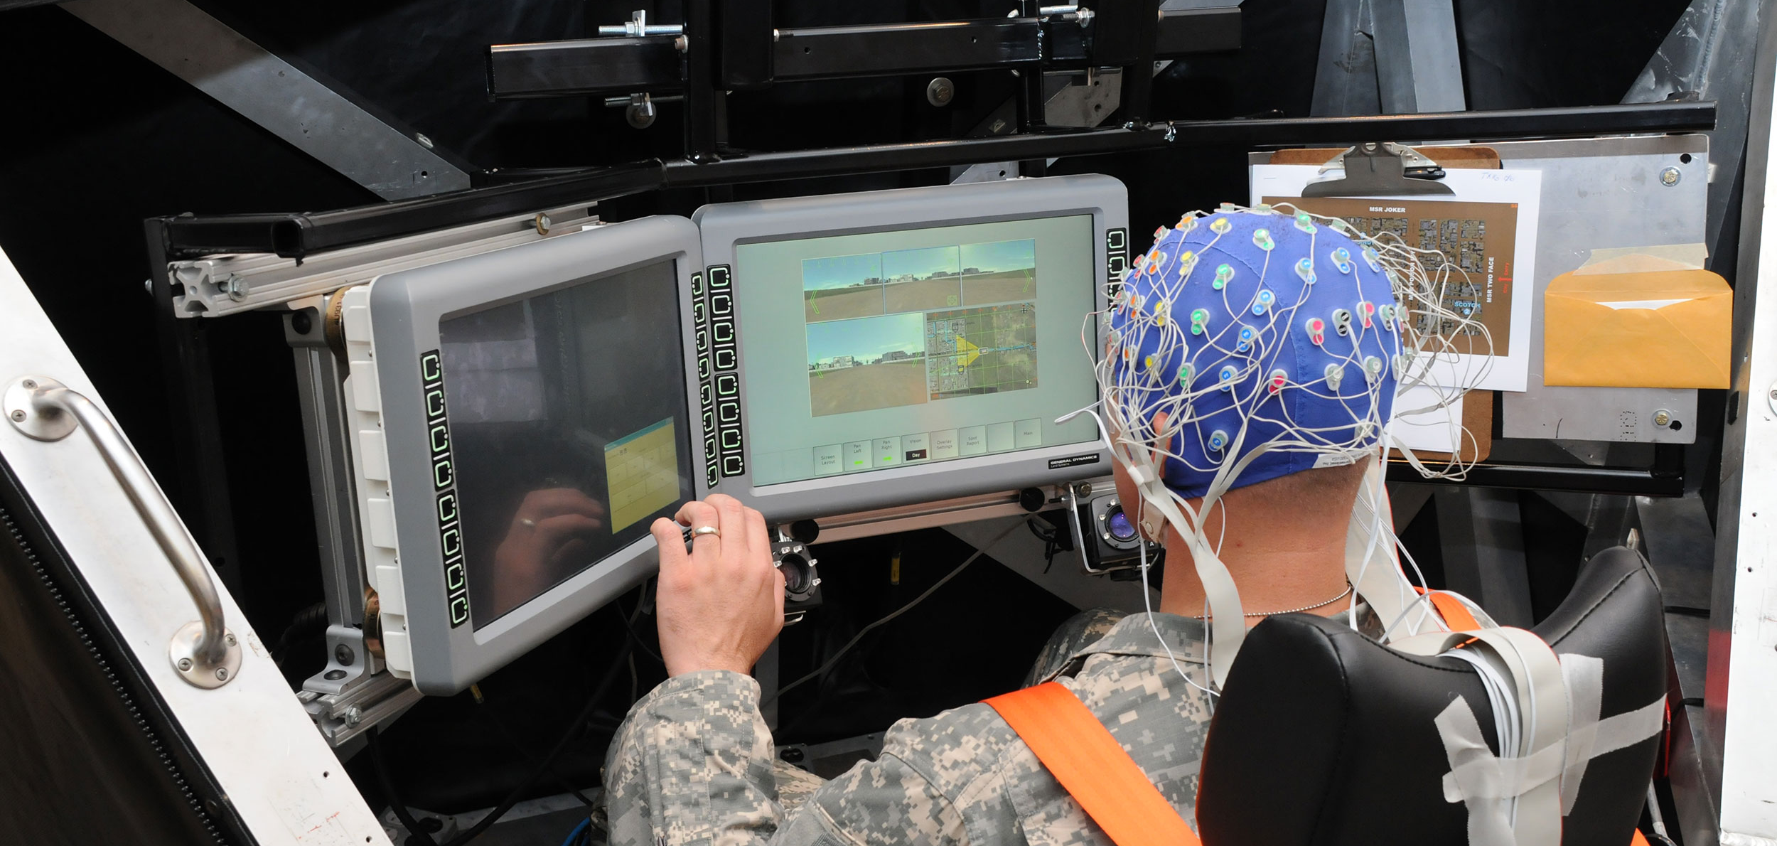

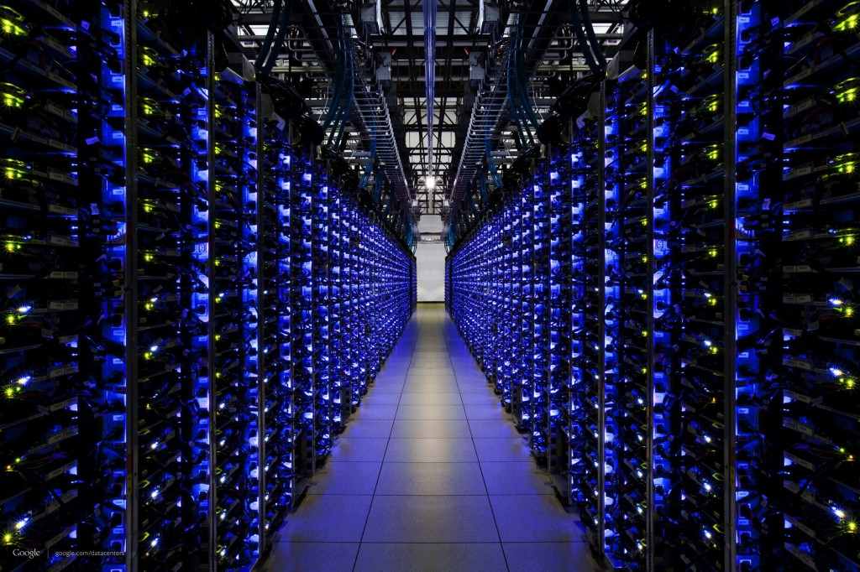

Slide 12
CS IS changing everything!!!
https://www.youtube.com/watch?v=QvyTEx1wyOY

Slide 13
CS @ UTEP
Our programs:
Bachelor’s of Science in Computer Science
Master’s of Science in Information Technology
Master’s of Science in Computer Science
Master’s of Science in Software Engineering
Security certificate accredited by NSA
Ph.D. in Computer Science

Slide 14
Our Alumni
Work at:
Google
Yahoo
Amazon
Facebook
Microsoft
NIST
IBM
GM
NASA
Exxon Mobil
USAA
ARL
…

Slide 15
Research in CS @ UTEP
Successful research teams in areas as varied as:
  Architecture
  Artificial Intelligence
  Decision Making
  Computational Sciences
  Software Engineering
  Security
  Funded by NSF, ARL, DARPA, Army Corps of Engineers, Google, NCWIT, Microsoft, …
CyberShare center: interdisciplinary research teams
Lead of the Computing Alliance for Hispanic Serving Institutions (CAHSI.org)

Slide 16
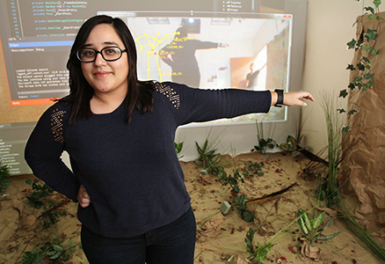
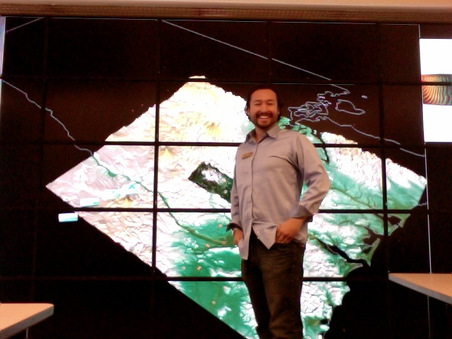
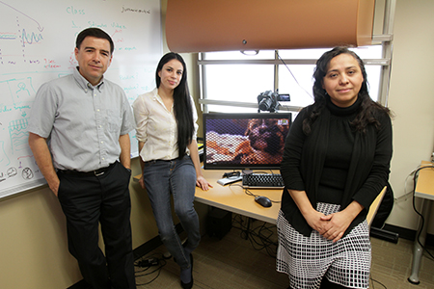

Slide 17
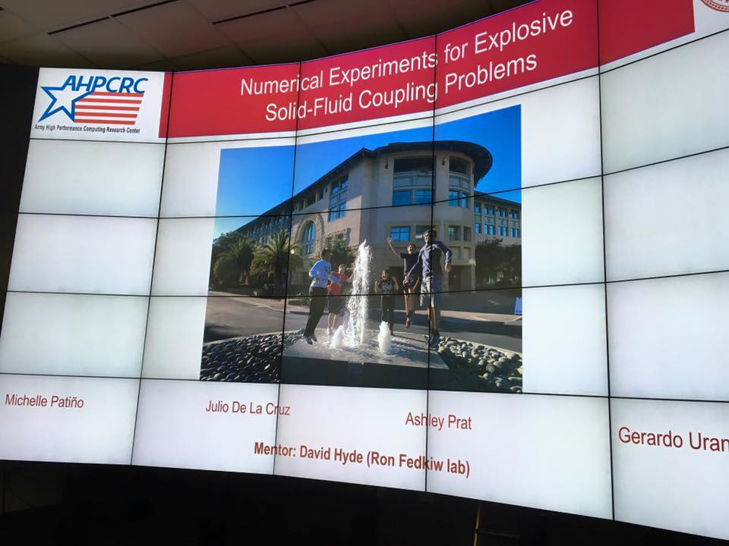

Slide 18
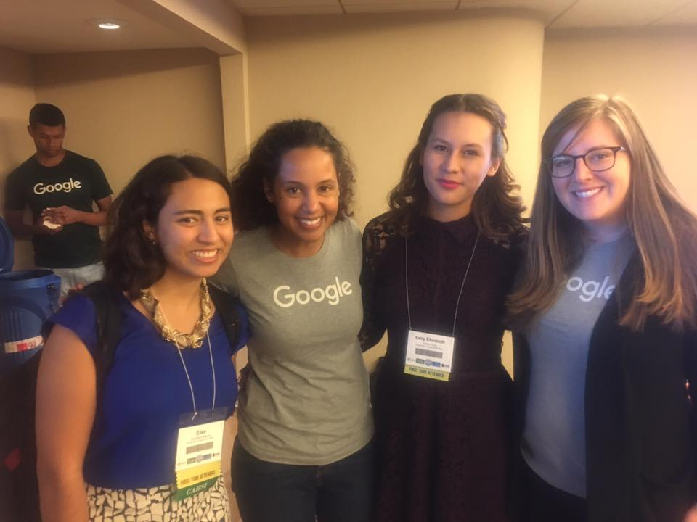
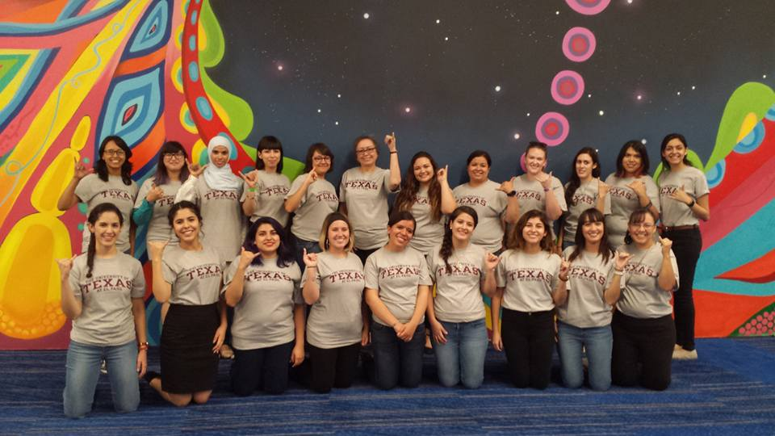

Slide 19
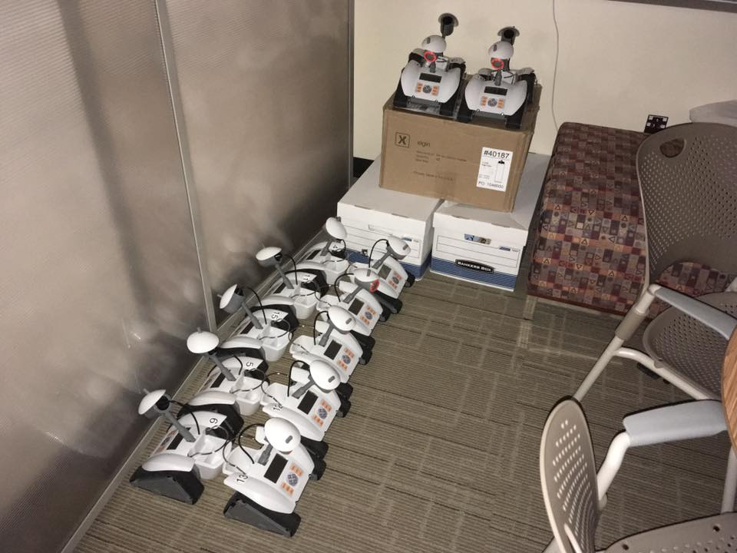
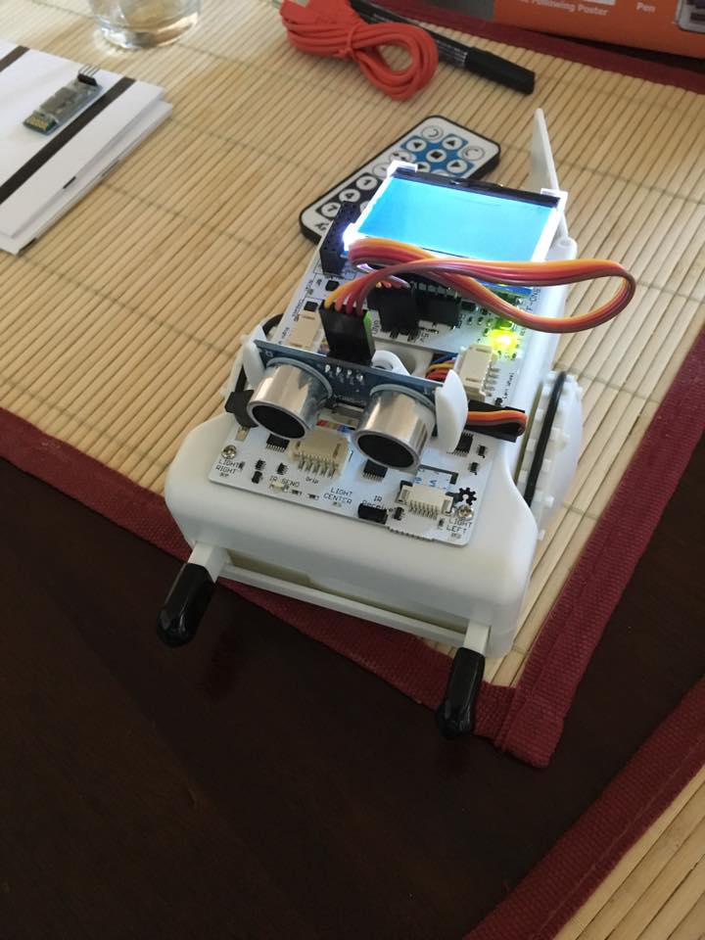
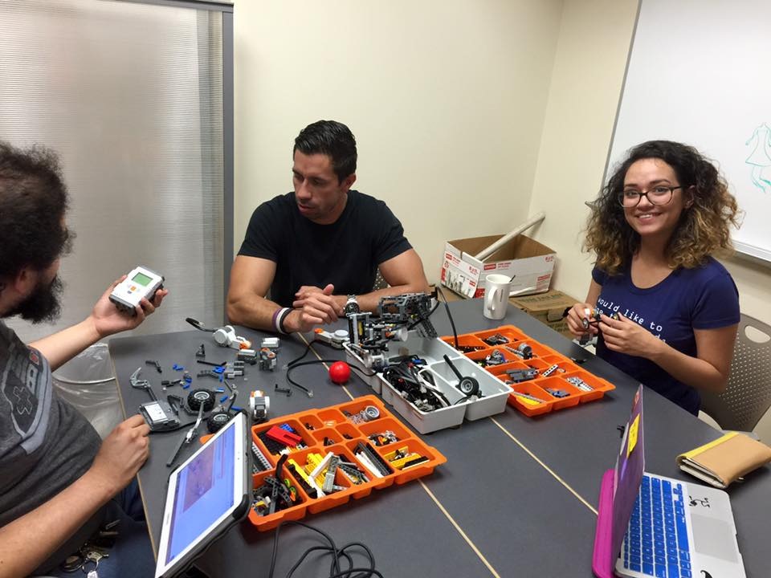

Slide 20
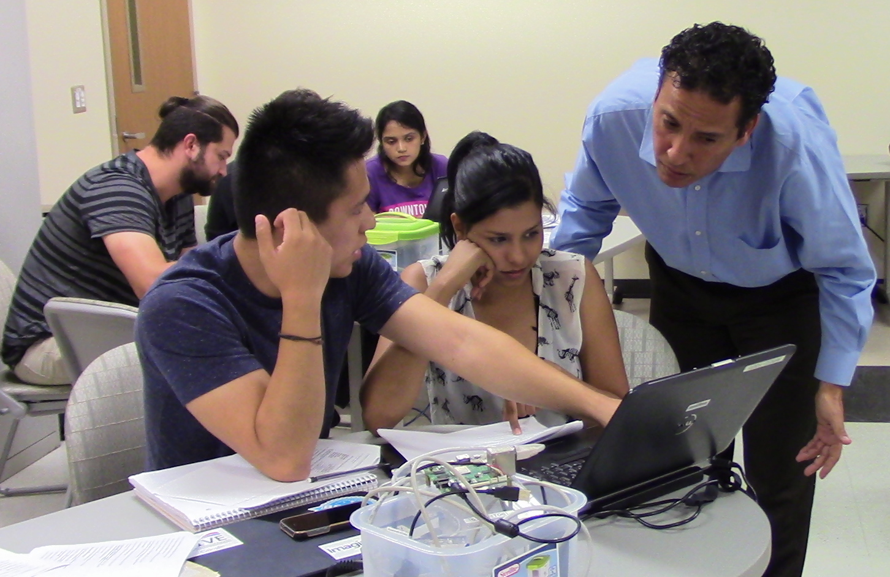
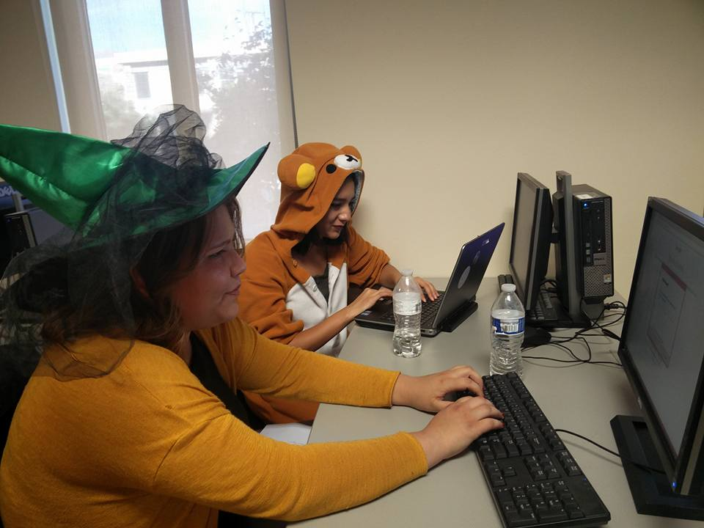
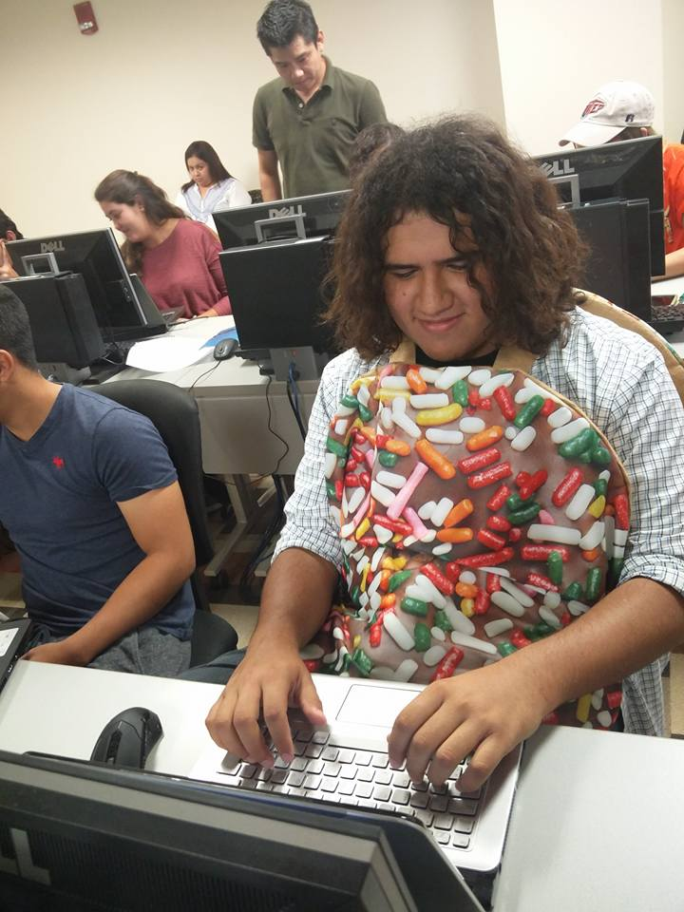
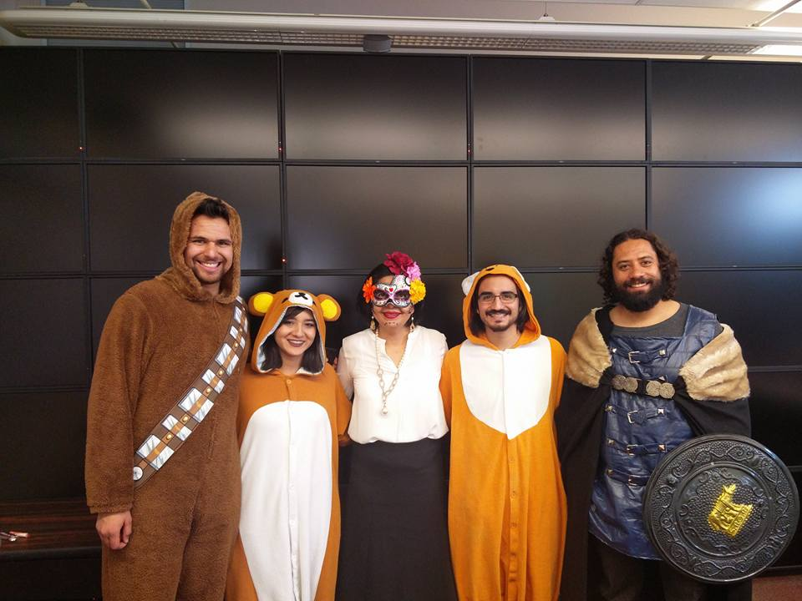

Slide 21
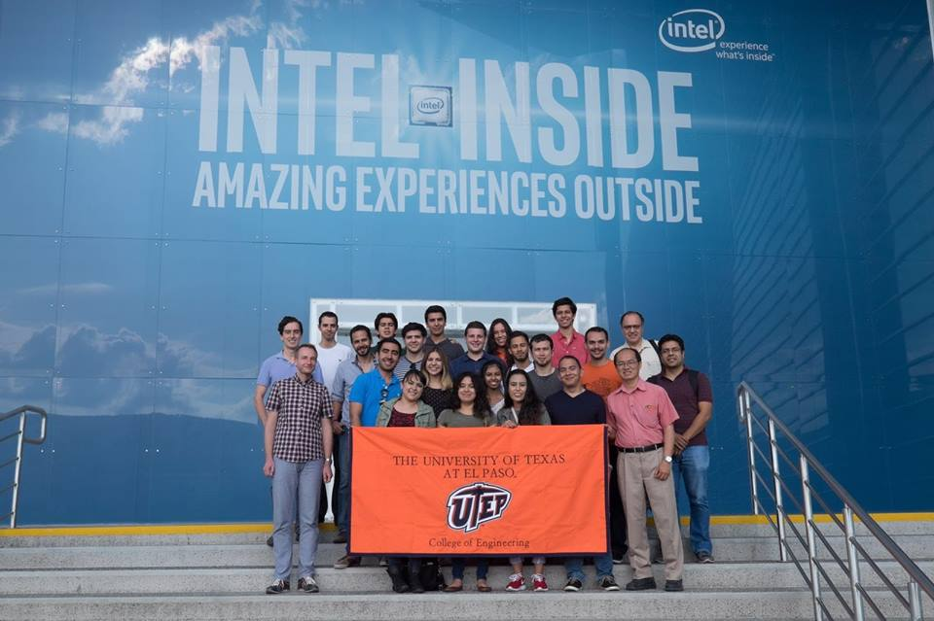

Slide 22
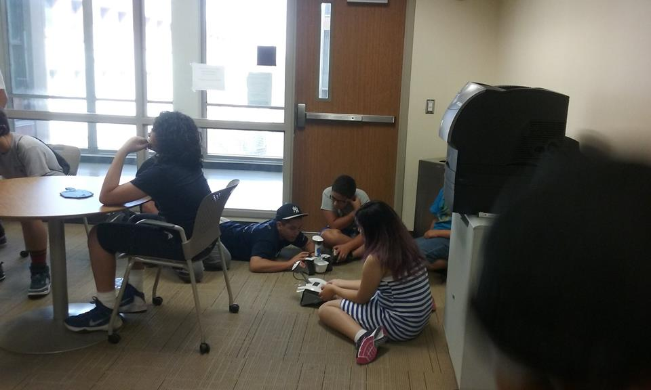

Slide 23
More resources
https://youtu.be/qYZF6oIZtfc
http://code.org
https://code.org/learn
http://scratch.mit.edu
https://itunes.apple.com/us/app/hopscotch-learn-to-code-creatively/id617098629?mt=8
http://pythonturtle.org
Etc.

Slide 24
How to become engaged?
Participate in summer camps
Excites summer camps in CS at UTEP:
http://engineering.utep.edu/plaza/excites/index.html
Join a CS research lab in summer
CONTACT ME: mceberio@utep.edu
Participate AND organize an Hour of Code
https://youtu.be/FC5FbmsH4fw
YOU can also do it on your own: plan events, Saturday Hour of Code events for your friends and community!

Slide 25
Are you doing CS already?
NCWIT Aspirations in Computing is for you!
Annual competition for High-School girls with interest (and some experience) in computing / technology
All you have to do: write a few paragraphs about your experience and aspirations (no coding at all)
Deadline to apply: Early November annually!!!
Let me know if you are interested for next year: I’ll keep you in my list for more information and help

Slide 26
We hope you have fun today!
If you like it, please request another visit! We are always very happy to have visitors!!!
You can also:
Practice at home with fun activities at http://code.org and many more!
Come during summer for Excites Summer Camps, from the College of Engineering
Join a CS research lab via the NEXUS Program of the College of Engineering
Take technology classes at P3 or other (summer) camps about technology
Participate in the annual NCWIT Aspirations in Computing program: http://aspirations.org
Contact me, or ask your parents to contact me, if you have questions and you want to learn more!
    Dr. Martine Ceberio, mceberio@utep.edu, http://martineceberio.fr

