Slide 1
Master’s in CS & Fast-track program
Info session
With Dr. Ceberio

Slide 2
A Graduate Degree in CS?

Slide 3
Planning Ahead
Higher income potential:
Estimated average bump in salary (compared with BSCS) = $16K/year (median = $131K/year)
Increased job prospects:
Some positions in Computer Science require a Master’s degree
Excellent job growth:
Computer and research scientist occupations are expected to grow 22% from 2020 to 2030

Slide 4
But also…
Ability to specialize:
E.g., Machine Learning, Security, Data Science → providing you with a sharper edge for job prospects
Gateway to completing a PhD degree:
Most PhD programs require a MS degree or let you get it “on the way”. If you ever consider continuing, a Master’s degree is a must

Slide 5
Keep This in Mind
A master's degree in computer science can be the gateway into one of the most well-compensated, high-demand careers today.
Grads with a master’s degree in computer science have more opportunities than those with just undergraduate degrees in the field. For example, computer and information research scientists are required to have a master’s degree, according to the Bureau of Labor Statistics. This is common for data scientist positions, as well.
If nothing else can convince you: You don’t want to be left behind in 10-15 years from now when most jobs will require an MS degree.

Slide 6
Fast-track program: What is it?

Slide 7
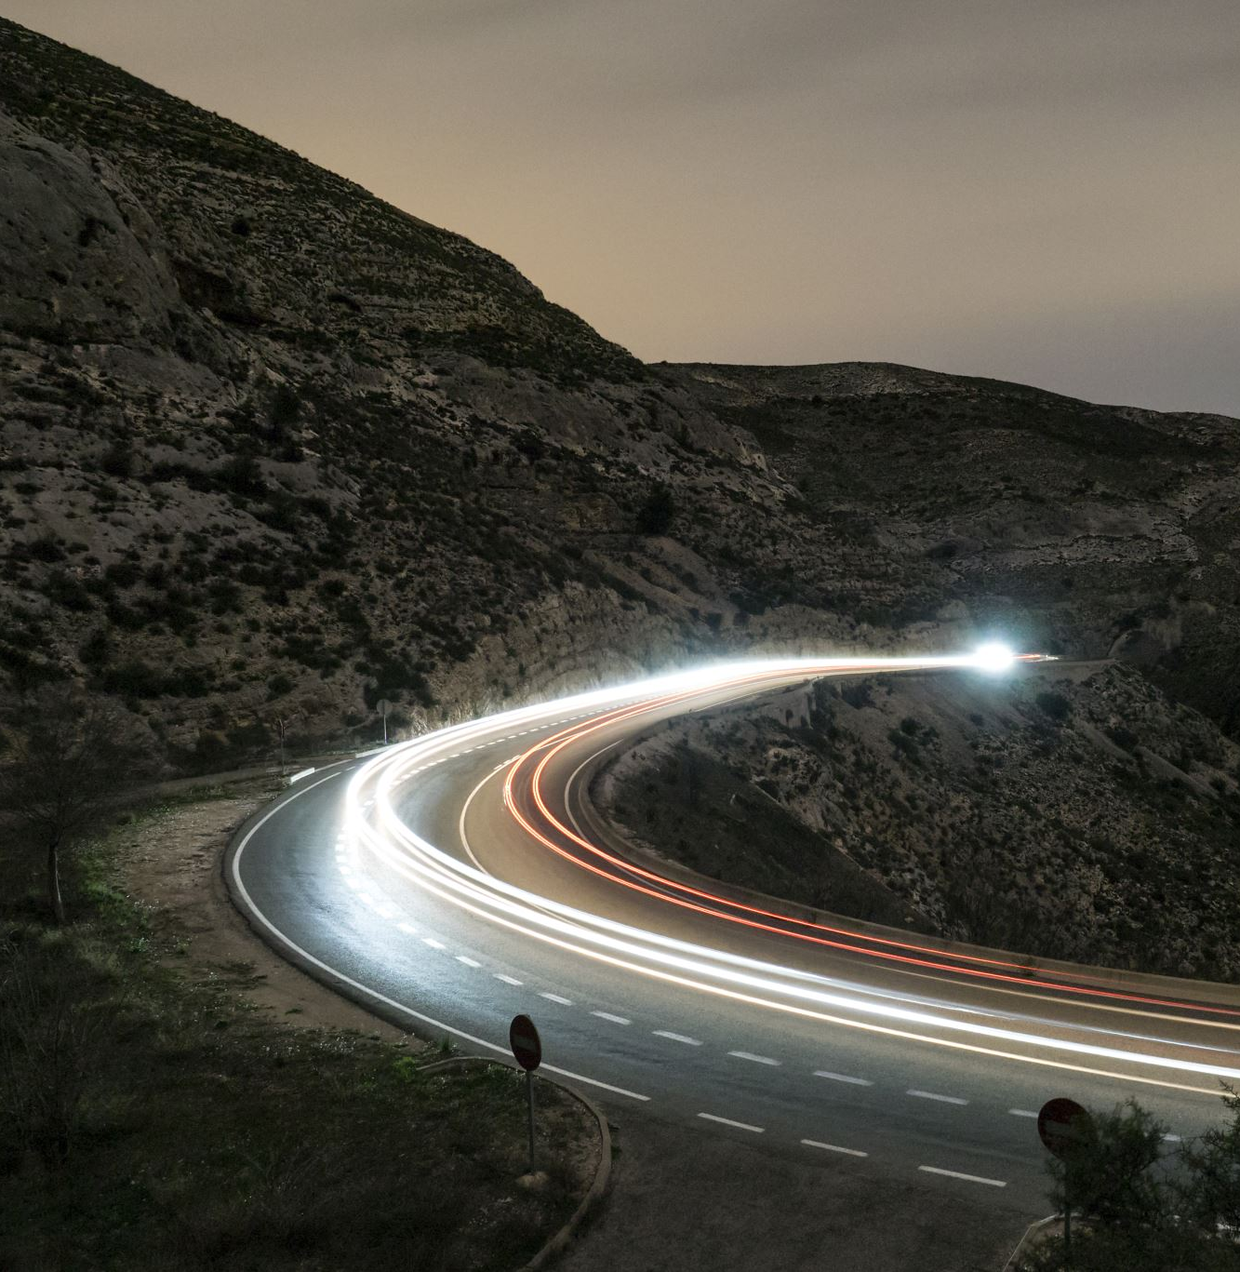
Fast-track program
How?
Accelerated path to get both your UG degree and your MS in CS
Take Grad courses to complete your UG degree
Note: the Fast-Track program also exists for the MSSwE and MSDIS – not discussed today.

Slide 8
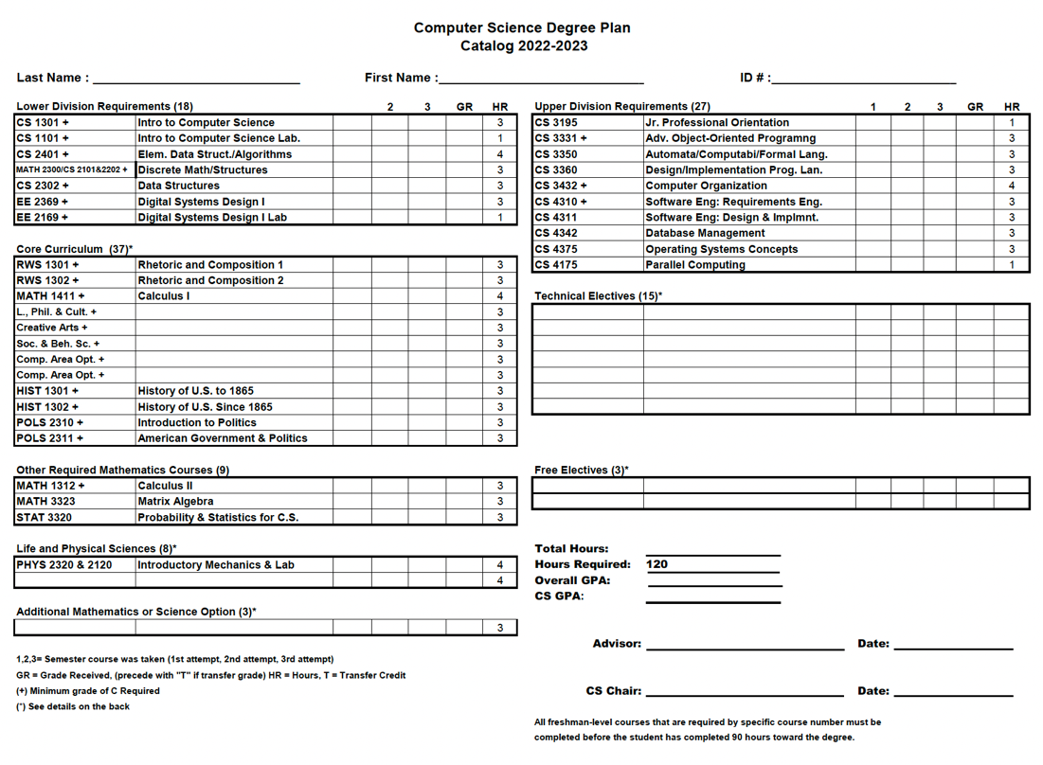
This is your CS UG degree plan
Up to your 5 electives (15 credits) cam be taken at the 5XXX level (graduate level)
What’s the point?
CS5XXX
CS5XXX
CS5XXX
CS5XXX
CS5XXX
Elective 1
Elective 2
Elective 3
Elective 4
Elective 5
Very conveniently:
The day you start grad school, you are already ahead with your degree.
Required:
90CH + GPA >= 3.3
http://catalog.utep.edu/admissions/graduate/fast-track/

Slide 9
Why is the Fast-Track a Good Thing?
Cost:
Financial aid applies for the 5 Grad courses you taking as a UG student (because you are completing your BSCS), BUT it would not work if you were to take them as a Grad student
Time:
MSCS = between 33 and 36 CH = 11-12 courses (for thesis or coursework only)
Fast-track → only 6-7 courses left to complete = 2 semesters after BSCS graduation

Slide 10
Not sure about completing an MSCS?
At UTEP, or at all?
Fear not ☺
MSCS at another institution?
No MSCS on the horizon?
Fast track = great bragging (recruiting) tool
You went beyond what you had to do to complete your BSCS
You proved that you are able to be successful in graduate level courses

Slide 11
Let’s Take a Look
Degree plan
Options
What to watch out for

Slide 12
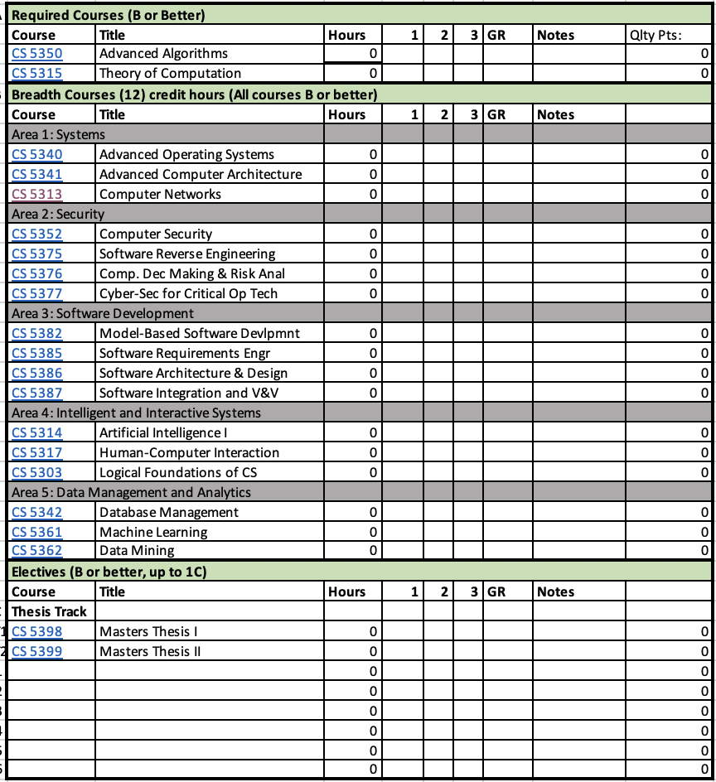
This is your MSCS degree plan
2 core courses
+ out of the 5 breadth areas: pick 4 and complete 1 course in each of the 4
+ 3 electives
+ thesis (1 and 2) OR 3 more electives
-----------------------------------------------------------
Total = 11 or 12 courses

Slide 13
Be careful
Fast program
Select your courses carefully
You do not want to take courses for the sake of it → you want to take courses that you care about
This is even more important if you want to do an MS with a thesis

Slide 14
What’s a Thesis? And why would I consider one?

Slide 15
Thesis
Research work
Original contribution to a field of CS you chose, along with a research advisor
Results in: publication, a thesis manuscript, a presentation (thesis defense)

Slide 16
Thesis or not Thesis? That is the Question…

Slide 17
Thesis vs. Non-Thesis
Both thesis and course Master's lead to the same degree.
Coursework-only option:
Usually for professionals who have been in the field for a number of years and want to further their education, get the “next” degree.
Likely a terminal MS and you're not going to have a strong PhD application.
Advantage: may give you the degree you “needed” for your work status, provides you with more tools and skills
Thesis option:
For students who want to become research scientists (incl. in industry)
For students contemplating a PhD or an academic career
For students who want to develop your research skills and ultimately narrow your focus to a more specialized field of study.
Advantage: demonstrates (de facto) your ability to: focus, deliver, work under time constraints, communicate effectively (in oral and written format) → sets you off the crowd

Slide 18
Let’s Get Concrete

Slide 19
Two Scenarios
1/ Fast-Track to MS with Thesis
2/ What about a certificate?

Slide 20
1/ Fast-track to MS with Thesis
What could go VERY wrong?
Fast track:
1 core courses
+ 4 electives
-----------------------------------------------------------
After BSCS graduation:
1 core courses
+ out of the 5 breadth areas: pick 4 and complete 1 course in each of the 4
+ thesis (1 and 2)
-----------------------------------------------------------
Total = 5 + 7 = 12 courses
And most importantly: no elective left to be taken in your field of research
What could go wrong?
Fast track:
2 core courses
+ 3 electives
-----------------------------------------------------------
After BSCS graduation:
+ out of the 5 breadth areas: pick 4 and complete 1 course in each of the 4
+ thesis (1 and 2)
-----------------------------------------------------------
Total = 5 + 6 = 11 courses
And most importantly: no elective left to be taken in your field of research
Elective 1
Elective 2
Elective 3
Elective 4?

Slide 21
1/ Fast-track to MS with a Thesis
What would work instead?
Fast track:
2 core courses
+ 3 breadth area courses
-----------------------------------------------------------
After BSCS graduation:
+ 1 breadth areas course
+ 3 elective courses
+ thesis (1 and 2)
-----------------------------------------------------------
Total = 5 + 6 = 12 courses
You defer your electives until you start, so you do not “shoot yourself in the foot”

Slide 22
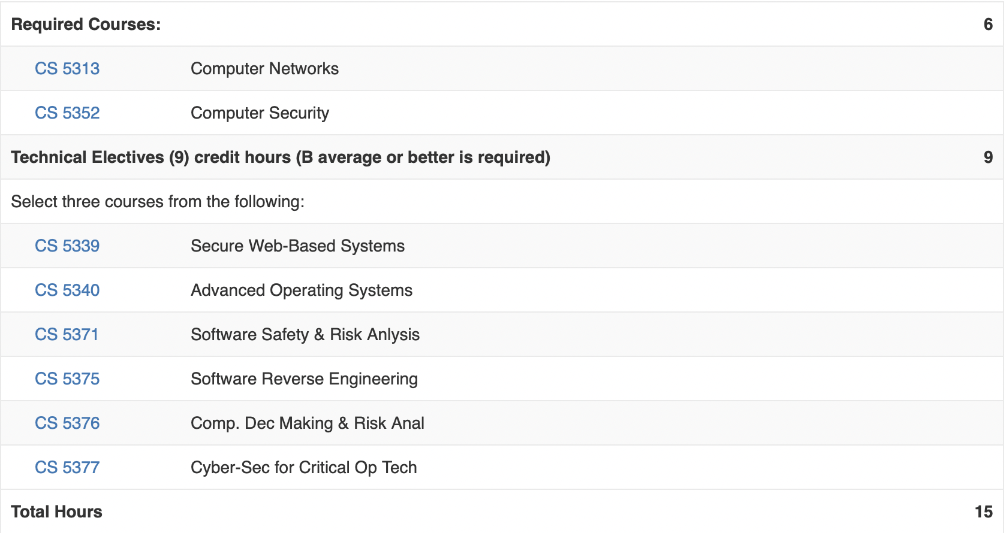
2/ Certificate along the way?
Requirements for the cybersecurity certificate:
Area 1: Systems
Area 2: Security
Elective
Area 1: Systems → elective
Elective
Area 2: Security → elective
Area 2: Security → elective
Area 2: Security → elective
All certificate electives = MSCS electives
If MSCS Thesis → no more elective

Slide 23
Thesis: Timeline?
Ideally: start as an UG student
Otherwise: 1 year to wrap it all up
Thesis in 1 year: DOABLE!
BUT you need to plan well
+ have an advisor who is on board!

Slide 24
Info Session Takeaways?
Consider Grad School: Much easier to do it now than to come back to it → ONLY 1 MORE YEAR
Thesis vs Non-Thesis: Think about what it is for + How to market it
Planning is everything: Make sure your MSCS is planned from now to graduation to avoid locking yourself in any configuration (→ regret or graduation delay = cost)

Slide 25
Questions?

Slide 26
References
https://www.utep.edu/cs/undergraduate/PDFs/Degree%20Plans/CSDegreePlan2022-2023.pdf
https://www.franklin.edu/blog/is-a-masters-in-computer-science-worth-it
https://www.computersciencedegreehub.com/faq/masters-degree-computer-science-worth-time-expense/
https://fortune.com/education/articles/what-can-you-do-with-a-masters-in-computer-science-degree/
https://caldo.ca/tools-to-apply/course-based-or-thesis-based-master/
https://www.gograd.org/resources/thesis-or-non-thesis-masters-degree/
https://www.topuniversities.com/student-info/admissions-advice/professional-masters-vs-research-masters-what-you-need-know
https://www.computerscience.org/careers/computer-information-researcher/
https://www.bls.gov/ooh/computer-and-information-technology/computer-and-information-research-scientists.htm
https://www.utep.edu/engineering/ece/academic-programs/fast-track-program-1.html
http://catalog.utep.edu/admissions/graduate/fast-track/

Slide 27
Thank you!
Contact me with any questions about the MSCS and the fast-track program BS to MSCS
Dr. Martine Ceberio – office CCSB 3.0406 – mceberio@utep.edu

