Slide 1
Uranus
By: Gonzague Saldaña-Ceberio

Slide 2
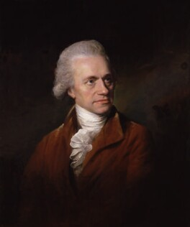
Uranus and who discovered the planet
Uranus was discovered by William Herschel in March 1781
Only 12 days after he had built his telescope!
For information: the first telescope dated back to 1608
Notes:
Uranus’ radius is 25,477 km
Uranus’ average solar orbit distance is 2,870,658,186 km

Slide 3
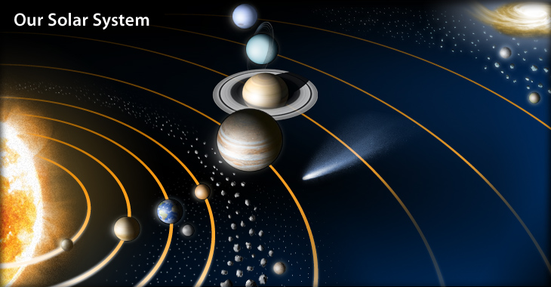
Where is Uranus exactly?
It is the 7th planet away from our Sun, just before Neptune.
So it was hard to see and could only be spotted using his newly built telescope
We had to wait another 75 years until Neptune was discovered!!!
Notes:
We had to wait another 75 years until Neptune was discovered!!!

Slide 4
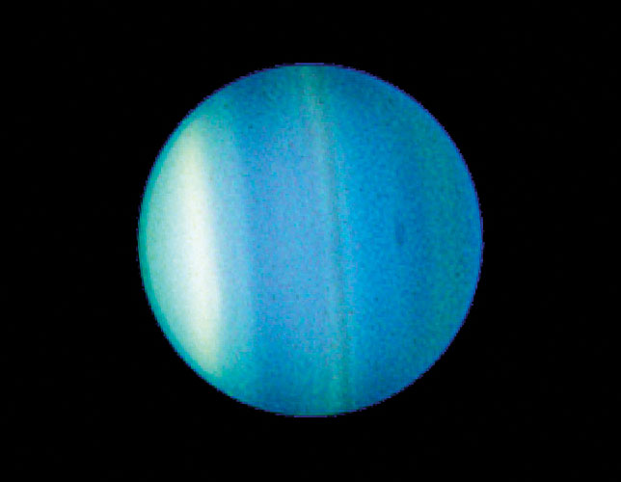
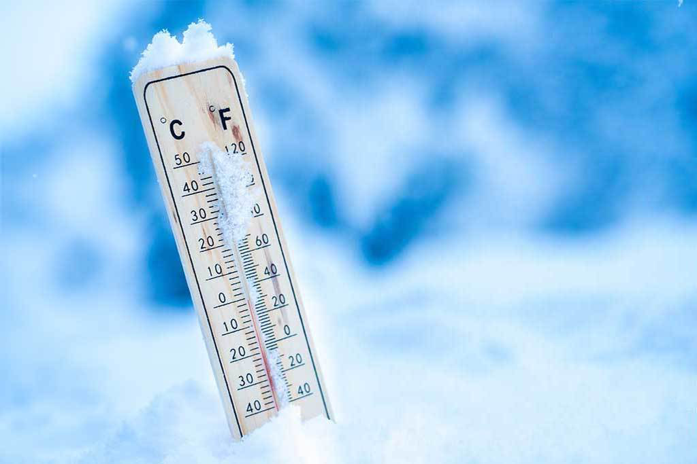
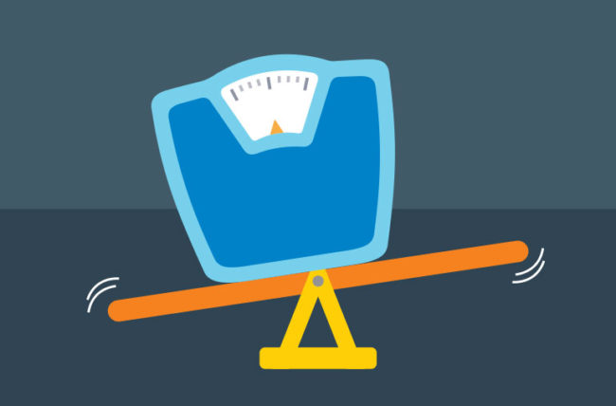
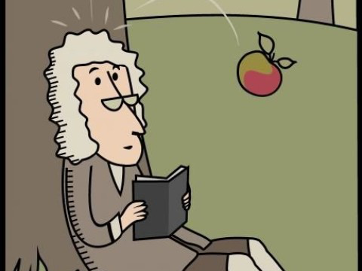
Quick Facts about Uranus
Day 17 hours 14 minutes
Year 84 Earth years
Radius 25,362 kilometers
Planet Type Ice Giant
Moons 27
Coldest temp. : -137ºC
86.8103 septillion kg
24,477 km / h
159,354.1km
8.87m/s2
Coldest temp. on earth : -93ºC
Earth’s weight: 5.974 septillion kg
earth velocity is 107,218 km / h
Earth’s circumference 40,030.2km
Earth’s surface gravity is 9.80665m/s²
Notes:
Average orbit distance from Sun: 2,9 B km
Composition: H (hydrogen), He (helium), CH4 (methane)
In comparison with Earth:

Slide 5
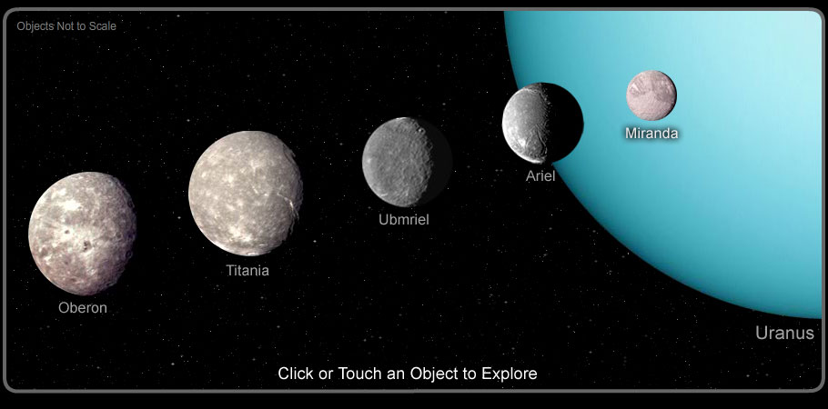
Ariel
Belinda
Bianca
Caliban
Cordelia
Cressida
Cupid
Desmonda
Ferdinand
Francisco
Juliet
Mab
Margaret
Miranda
Oberon
Ophelia
Perdita
Portia
Prospero
Puck
Rosalind
Setebos
Stephano
Sycorax
Titania
Trinculo
Umbriel
Here is a video of some of Uranus’ moons: https://www.youtube.com/watch?v=2vr0a5ZkxwA

Slide 6
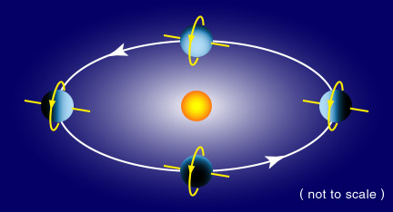
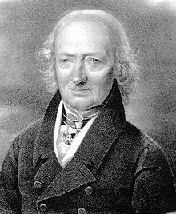
More Facts about Uranus
Fun Fact #1:
Uranus is the only planet that revolves on its horizontal axis
Comparison with Earth:
Uranus has a radius 4 time larger than the Earth’s, but the Earth can fit in Uranus 63 times!
If Uranus was a basketball, the Earth would be a large apple.
Fun Fact #2:
Uranus is the only planet with the name of a Greek God (all others have Roman Gods’ names)
Uranus: God of the Sky;
Grandfather of Jupiter, father of Saturn
Other proposed names: Georgium Sidus, Herschel, Neptune, …
Finally named by J. E. Bode in March 1782
Notes:
Average orbit distance from Sun: 2,9 B km
Composition: H (hydrogen), He (helium), CH4 (methane)
In comparison with Earth:

Slide 7
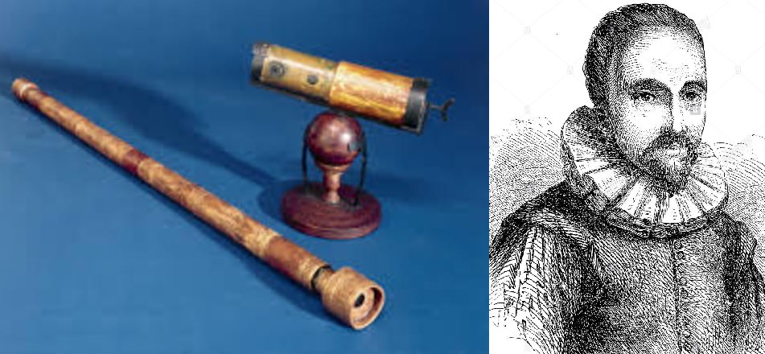
Uranus special event timeline
1787-1851
Four Uranian moons discovered and named
Titania, Oberon, Ariel, and Umbriel.
Jan 24 1986
Voyager 2 made a voyage to Uranus and discovered 10 new moons and 2 new rings
March 13 1781
British astronomer William Herschel discovers Uranus
1948
Another moon, Miranda, is discovered
2006
Discovered an outer ring is blue but an inner ring is reddish
1608
present
1608
The first telescope was released
March 1782
Uranus got its name
Dec 2007
Uranus reaches equinox: it’s where the planet is fully illuminated as the Sun passes over its equator
March 10 1977
Scientist found Uranus has rings while observing a star.
March 1 1781
William Herschel built his telescope
Dec 2005
Discovery of a pair of rings and two new moons

Slide 8
Resources
https://www.worldatlas.com/articles/how-did-uranus-get-its-name.html
https://solarsystem.nasa.gov/planets/uranus/overview/
https://solarsystem.nasa.gov/planets/uranus/in-depth/
https://solarsystem.nasa.gov/planets/uranus/by-the-numbers/
https://solarsystem.nasa.gov/planets/uranus/exploration/?page=0&per_page=10&order=launch_date+desc%2Ctitle+asc&search=&tags=Uranus&category=33
Thank you for listening, any questions?

