Slide 1
The university of Texas at El Paso computer science
Ann Q. Gates
Professor and Chair
Director - CREST CyberShare Center of Excellence
Director - CAHSI INCLUDES
Martine Ceberio
Professor

Slide 2
Five-Year Growth
2014-2018

Slide 3



Support for Change

Slide 4
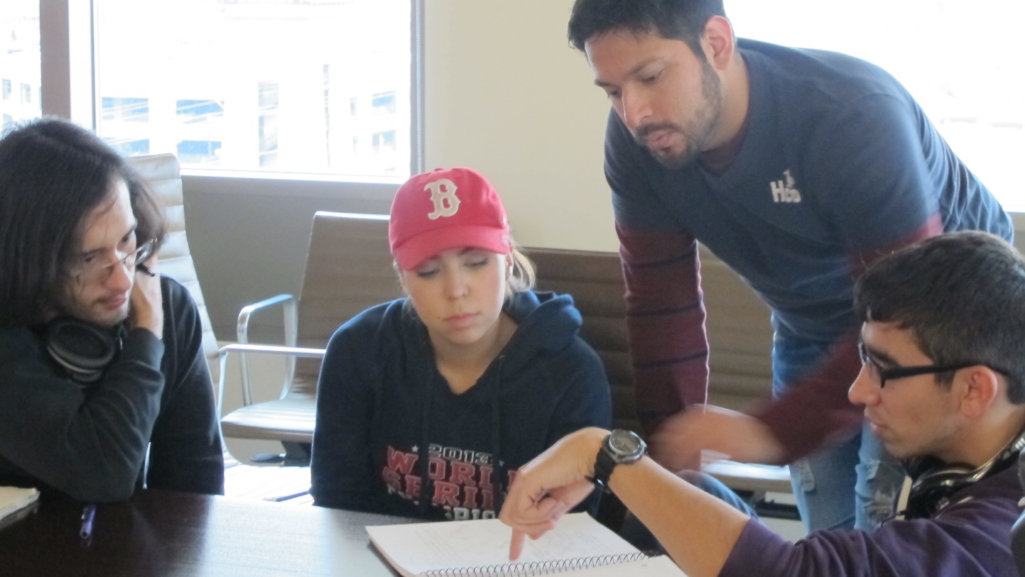
Peer-Led Team Learning
Undergraduate students lead near-peers in activities designed to enhance conceptual knowledge of course.
Origins: (Dr. Gosser City College of New York, Chemistry education)
CAHSI adapted by incorporating cooperative learning elements
    Positive Interdependence
    Individual Accountability
    Group Processing
    Social Skills
    Face-to-Face Promotive Interaction

Slide 5
PLTL: Impact on Hispanics and Women
Impact of PLTL on course completion rates |  | PLTL
 |  | BEFORE PLTL (n=4023) | AFTER PLTL (n=1172) | Difference (PLTL – Before)
 |  | Percentage
GENDER | FEMALE | 74% | 87% | 13%
 | MALE | 78% | 87% | 9%
HISPANIC | NON-HISPANIC | 80% | 84% | 4%
 | HISPANIC | 86% | 92% | 6%
Hispanic students showed significant increases in course completion
after PLTL was implemented, x²(1, N=2716)=17.4, p<.01.

Slide 6
PLTL:
Self-efficacy
Students reported that PLTL increased their self-efficacy in computing (scale mean=7.93/10, S.D. 2.31, n=284)
“I was always worried that I don’t know enough, or [there are] some programming strategies that I haven’t quite gotten yet… [but] I feel that I can really break a problem down into smaller steps and build my way up. And I think that’s a good skill to learn for programming and I also think that I work well in groups. I know that in jobs you’re always going to work in groups.”
Notes:
1=strong decrease
10=strong increase

Slide 7
Affinity Research Groups
A comprehensive model
Creates and maintains dynamic, productive, and inclusive research groups.
Involves the deliberate design of research groups whose members share a common purpose – an affinity
Emphasizes the conscious development of students’ disciplinary knowledge, research abilities, and team skills
Provides a sense of professional identity and belonging.

Slide 8
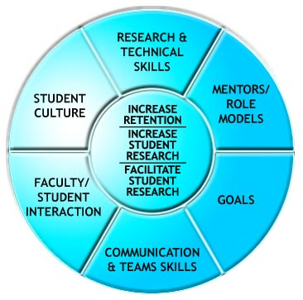
An ARG is a non-hierarchical
model that promotes:
  Collection of best practices
  Cooperative group interaction
  Deliberate and intentional development and practice of skills
  Support structures
Expand participation by recruiting
students who may not normally be
involved in research

Slide 9
ARG: Benefits for Hispanic Students
87% of students reported that they were more likely to attend graduate school because of their ARG experience
**p<.01, *p<.05 ; independent samples t-tests
URSSA scales (4-point scale) | Hispanic students (n=) Means (S.D.) | Non-Hispanic students (n= ) Means (S.D.)
Career and graduate school preparation ** | 3.40 (.49) | 3.09 (.65)
Intellectual gains * | 3.36 (.47) | 3.11 (.46)
Skills* | 3.30 (.46) | 3.06 (.53)
Collaboration | 3.36 (.39) | 3.25 (.37)
Personal growth | 3.35 (.45) | 3.27 (.48)

Slide 10
ARG: Entering the professional research community
Professional activity undertaken in the last year | Number of out-of-class ARG students (n=143) | % of ARG students (n=143) | # of national sample of research students (NSF REU) (n=464) | % of national sample (n=464)
Attended a professional conference*** | 88 | 62% | 105 | 23%
Authored or co-authored a journal article ** | 18 | 13% | 25 | 5%
Presented a conference paper or poster*** | 54 | 38% | 67 | 14%
*** p<.001, **p<.01; independent samples t-tests

Slide 11
Reimagining CS
Introduction of 1- and 2-credit hour courses
Problem-solving courses
Cybersecurity workshops
Discrete Structures
Concentrations
Software Engineering
Secure Software Systems
Data Analytics
New courses to support minors and students who need to level
Introduction of new degree programs
NSF Grant 1042341
Re-imagining what it means to learn, whose knowledge counts, and what counts as knowledge.

Slide 12

CAHSI-Google
Problem Solving Courses

Slide 13
Features
Teaching Methods
Problem-Based Learning, a proven instructional model
Active learning strategies mirroring problem solving of professionals
Cognitive apprenticeship
IDEAL framework
Identify the problem;
Define the problem by thinking about it and sorting relevant information;
Examine the options and potential solutions;
Act on a plan and strategies;
Look at the consequences and evaluate the effects of the activity.
Modeling
Coaching
Scaffolding

Slide 14
CAHSI-Google
Problem Solving Courses
Faculty Reflections
We're problem solvers, as computer scientists. And yet, it feels like we have stopped, or forgotten, or been too busy to make it more explicit in our regular (core) classes. The problem-solving course is our remedy.
One of the biggest things that we have learned by running these classes is how... we're seeing big holes in our curriculum. This is forcing us to understand what students want to get out of our program… we need to be more proactive to actually train them to do the stuff they need to do on the job.

Slide 15
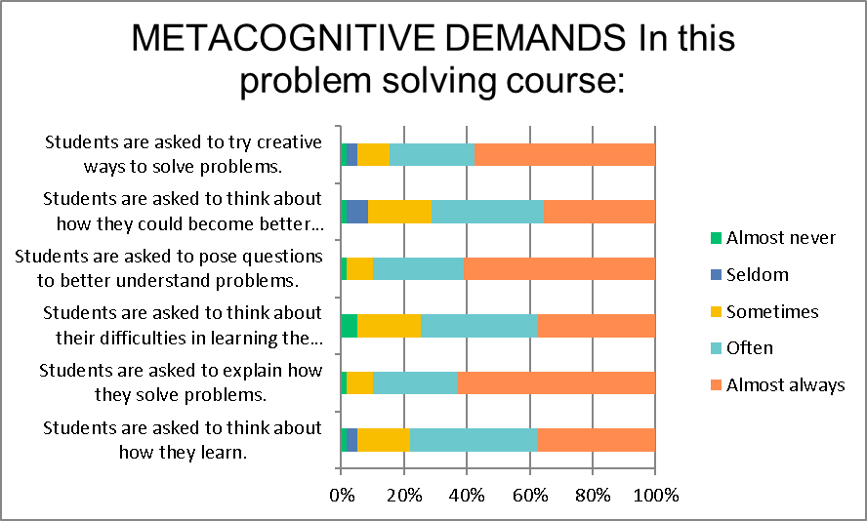
Problem Solving as a Learning Environment Focused on Process
  Students in the spring 2019 survey cohort state that their problem-solving courses help them develop metacognitive skills. Specifically:
    Solve creatively
    Pose questions about the problem
    Explain HOW they solve problems
    more than 80% state often/almost always

Slide 16
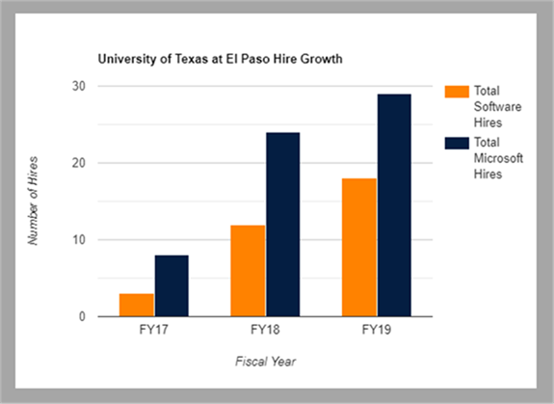
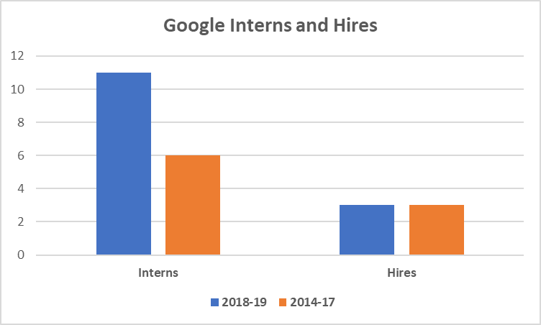
Competitive Positions
Microsoft Hires
10 interns in FY19 vs. 3 previous year.

Slide 17
Other courses

Slide 18
One-Credit Hour Course Cyber Security
Salamah Salamah*
*Collaboration with ARL and industry
Workshop-style course introducing students to:
  Current software vulnerabilities
  Cyber operation techniques
  Defense and mitigation techniques
  Cybersecurity analysis tools
10 workshops in total including:
  Route hijacking
  Buffer overflow
  Android security
  Reverse engineering
  Digital forensics

Slide 19
Discrete Structures as a 1+2 Sequence
Discrete Math used was a bottleneck in our curriculum
Lack of genuine alignment and motivation for our CS students
Split into a 1hr + 2 hrs sequence, offered along with CS1 and CS2

Slide 20
CS1 Redesign
Emphasis on students’ prior knowledge
Not from CS courses
But from their own daily lives
Use of physical props to practice CS concepts
Focus on problem solving:
Concepts
White-boarding activities
Meaningful labs
Grading focused on acquisition of skills
Encouragement of practice and growth
Failure-safe environment

Slide 21

On-going CS2 redesign
Focus on growth and skills
Focus on problem solving
Emphasis on extracurricular opportunities (such as internships)
All while adjusting to growing enrollment

Slide 22
Faculty Brownbag Meetings
Increase communication between faculty
Increase collegiality
Center conversations on students’ success
  Student success is always our concern
  Exchanging ideas on student success makes our efforts more efficient

Slide 23
Departmental Climate
Gauge student climate
Classroom culture; access to resources
Engage faculty in survey development & climate analysis
Collaborate on development of student survey
Conduct workshops
Audience: TAs, IAs, peer leaders, students, outreach leads
Departmental experiences; involvement in opportunities
Define actions to improvement
Culture and identity
Celebration of assets
Relate curricular and co-curricular experiences to advantages
Sense of community, identity and belonging; life demands
Preparation for success
Analyze climate results through small group discussions
Notes:
If your department collects student data regarding such things as classroom environment, students’ experiences in the department regarding sense of community and belonging, access to opportunities, and/or how students identify with the discipline, it can be impactful to engage faculty in discussions about student perspectives on these issues. If the department does not collect data, then working as a team with a social scientist to design a survey to assess student climate and experiences can create ownership on improving student climate. Preparing and training teaching and instructional assistants is another important aspect of establishing inclusive environments, in particular considering that they are your eyes and ears for identifying and connecting with at risk students.

Slide 24

Questions
agates@utep.edu
mceberio@utep.edu

