Slide 1
Computer Science Opportunities for Middle and High-School Students
Dr. Martine Ceberio
Associate Professor of Computer Science
August 16, 2018
Building GRIT -- 2ND ANNUAL CANUTILLO ISD PROFESSIONAL DEVELOPMENT CONFERENCE

Slide 2
Welcome to this session
Let’s get to meet each other

Slide 3
Welcome to this session
Let’s get to meet each other
Now take 3 to 5 minutes to introduce yourself to your nearest two neighbors (form groups of 3)
AND share with your group why you are attending this session

Slide 4
Goal of this session
Share with you opportunities for students
That we have at UTEP
Or that we hear about through our work
This talk is somehow a catalog
Not exhaustive
A way of passing information, from my own experience

Slide 5
Opportunities
There are many
Most are under-used
In this presentation: a tour of a subset of them

Slide 6
What type of opportunities?
Activities, camps, programs, community service
For students of middle and high schools
To broaden their horizons, to acknowledge their passions, to enhance their college dossiers, to enhance their confidence, to given them a better view of what they might or might not want to do when they grow up
In other words: for new comers as well as for students who are already passionate about computer science

Slide 7
Here is today’s menu
NCWIT AiC
Aspire IT
Excites
Nexus
Tours
Hour of code
Google internships (CSSI)
(formerly Google) IgniteCS
AI for all
And then so much more on their own…

Slide 8
But before we start…
QUESTION:
Why do we need such opportunities for our students?
Take 5 minutes to discuss this with your group of 3

Slide 9
Discovering
NCWIT AiC
Aspire IT
Excites
Nexus
Tours
Hour of code
Google internships (CSSI)
(formerly Google) IgniteCS
AI for all
And then so much more on their own…

Slide 10
Excites summer camps
Participate in summer camps
Excites summer camps in CS at UTEP:
http://engineering.utep.edu/plaza/excites/index.html

Slide 11
Tours
Several groups in the CS department give tours
It depends on availability
Day-long or half-day long in general
How?
Contact department or faculty
Example:
General intro to CS
Programming with robots
Programming with Scratch, Python, or Kodu
Intro to cryptography
Etc.

Slide 12
IgniteCS (or the like)
CS students-led introduction to computer science
For middle-school and high-school students
At UTEP: ACMW has led this program since its creation by Google (now not driven by Google anymore)
They take a school per year usually
How? Contact me or Dr. Villanueva-Rosales
To express interest

Slide 13
Exploring
NCWIT AiC
Aspire IT
Excites
Nexus
Tours
Hour of code
Google internships (CSSI)
(formerly Google) IgniteCS
AI for all
And then so much more on their own…

Slide 14
Nexus
Join a CS research lab in summer
http://engineering.utep.edu/plaza/Nexus/index.html
It is a shadowing internship
In my lab:
Intro to programming
2 projects (from pitching to developing, and presenting)
Command line training
Testing for my lab’s research
Group presentations

Slide 15
Examples of Nexus Work
http://cr2g.constraintsolving.com/updates
http://cr2g.constraintsolving.com/updates/page/2

Slide 16
Research in CS @ UTEP
Successful research teams in areas as varied as:
Architecture
Artificial Intelligence
Decision Making
Computational Sciences
Software Engineering
Security
Funded by NSF, ARL, DARPA, Army Corps of Engineers, Google, NCWIT, Microsoft, …
CyberShare center: interdisciplinary research teams

Slide 17
AI4All
http://ai-4-all.org
Currently in development
Raising awareness and competency in AI for high-school students
May start next summer

Slide 18
Community Service
NCWIT AiC
Aspire IT
Excites
Nexus
Tours
Hour of code
Google internships (CSSI)
(formerly Google) IgniteCS
AI for all
And then so much more on their own…

Slide 19
AspireIT
https://www.ncwit.org/project/aspireit-k-12-outreach-initiative-girls
Neer-peer program: led by students
K-12 outreach initiative fir girls

Slide 20
Hour of code
https://hourofcode.com/us
Annual program to expose more people to computing
It can easily be led by students
https://youtu.be/FC5FbmsH4fw
It does not have to be during the annual HoC week

Slide 21
Be acknowledged
NCWIT AiC
Aspire IT
Excites
Nexus
Tours
Hour of code
Google internships (CSSI)
(formerly Google) IgniteCS
AI for all
And then so much more on their own…

Slide 22
NCWIT Aspirations
https://www.aspirations.org
Aspirations in computing
For high-school young women
With interest in computing
Prestigious award: regional and national
Can enhance a college dossier, even bring scholarships

Slide 23
Are you doing CS already?
NCWIT Aspirations in Computing is for you!
Annual competition for High-School girls with interest (and some experience) in computing / technology
All you have to do: write a few paragraphs about your experience and aspirations (no coding at all)
Deadline to apply: Early November annually!!!
Let me know if you are interested for this year: I’m always happy to help

Slide 24
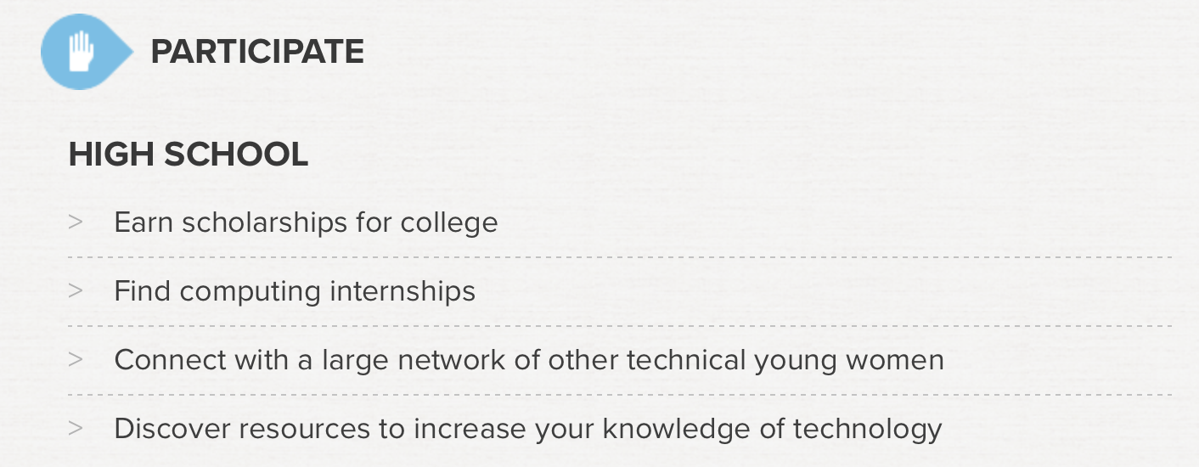

Slide 25
Dive deeper into CS
NCWIT AiC
Aspire IT
Excites
Nexus
Tours
Hour of code
Google internships (CSSI)
(formerly Google) IgniteCS
AI for all
And then so much more on their own…

Slide 26
Google Internships
https://buildyourfuture.withgoogle.com/programs/computer-science-summer-institute/#!?detail-content-tabby_activeEl=detail-overview-content
For students about to join a computing-related major in college
At Google or at an extension program

Slide 27
NCWIT AiC 2017-18
This past year 2016-17, we received 25 applications!
Benefits:
Prizes: last year, robots at the local level and laptops at the national level
Scholarships for some universities
Find internships more easily
Enter a closed network of very successful young women like you: some already accomplished professional
Contact me at: mceberio@utep.edu

Slide 28
What to do…
Take a few minutes and share thoughts with your team about what seems:
Most / least attainable
Most/ least appealing

Slide 29
There is more…
Take a few minutes to share with your team:
What you think is missing
Any other program you’d like to share

Slide 30
Other resources
https://youtu.be/qYZF6oIZtfc
http://code.org
https://code.org/learn
http://scratch.mit.edu
https://itunes.apple.com/us/app/hopscotch-learn-to-code-creatively/id617098629?mt=8
http://pythonturtle.org
Etc.

Slide 31
Thank you for your attention
Do you have any question?
Feel free to contact me at: mceberio@utep.edu

