Slide 1
Computational Thinking in the Classroom
Dr. Martine Ceberio
Computer Science Department, UTEP
February 19, 2018 – El Paso High School

Slide 2
Today’s Plan
Computational Thinking: What? Why? How?
Some of my experience
Opportunities for you and your students

Slide 3
Computational Thinking
What?
Why?
How?

Slide 4
Computational Thinking?
A way of:
Solving problems,
Designing systems, and
Understanding human behavior that draws on concepts fundamental to computer science.

Slide 5
Computational Thinking [cont’d]
Computational thinking (CT) is a problem solving process that includes a number of characteristics, such as logically ordering and analyzing data and creating solutions using a series of ordered steps (or algorithms), and dispositions, such as the ability to confidently deal with complexity and open-ended problems.
CT is essential to the development of computer applications, but it can also be used to support problem solving across all disciplines, including math, science, and the humanities. Students who learn CT across the curriculum can begin to see a relationship between subjects as well as between school and life outside of the classroom.
[from Google for Education: https://edu.google.com/resources/programs/exploring-computational-thinking/]

Slide 6
Computational Thinking [cont’d]
To flourish in today's world, computational thinking has to be a fundamental part of the way people think and understand the world.
[from Carnegie Mellon University]

Slide 7
Computational thinking [cont’d]
Algorithmically solving problems
Solving problems applies to any discipline
Formulating problems such that computers can assist
In our digital age, knowing what can, cannot, should, etc. be done will be extremely valuable
Analyzing and logically processing data
Generalizing and applying this process to other problems
Abstraction, reusability, versatility

Slide 8
Computational Thinking… Why?
Being able to solve problems is relevant to many disciplines
Law, medicine, engineering, etc.
Problem-based learning (to some extent at least) has proven to be very successful
Exposing students to problem-solving and possibly computer science will give them more options for careers

Slide 9
Computational Thinking… How?
Obviously, this is central to Computer Science ☺
Mathematics: posing problems and using the right tools to solve them
But not only… What else?
Tell me what you do in your classes

Slide 10
Examples
Computer science:
Problem solving rather than sole focus on coding
More and more focus on this
UTEP collaboration with Google
CS unplugged
Kodu or similar
Mathematics:
Posing problems rather than executing operations, repeating
Putting activities in context yield higher engagement and content retention
Show that many ways exist to solve a given problem, so that students have to think and pick
Use simple robots

Slide 12
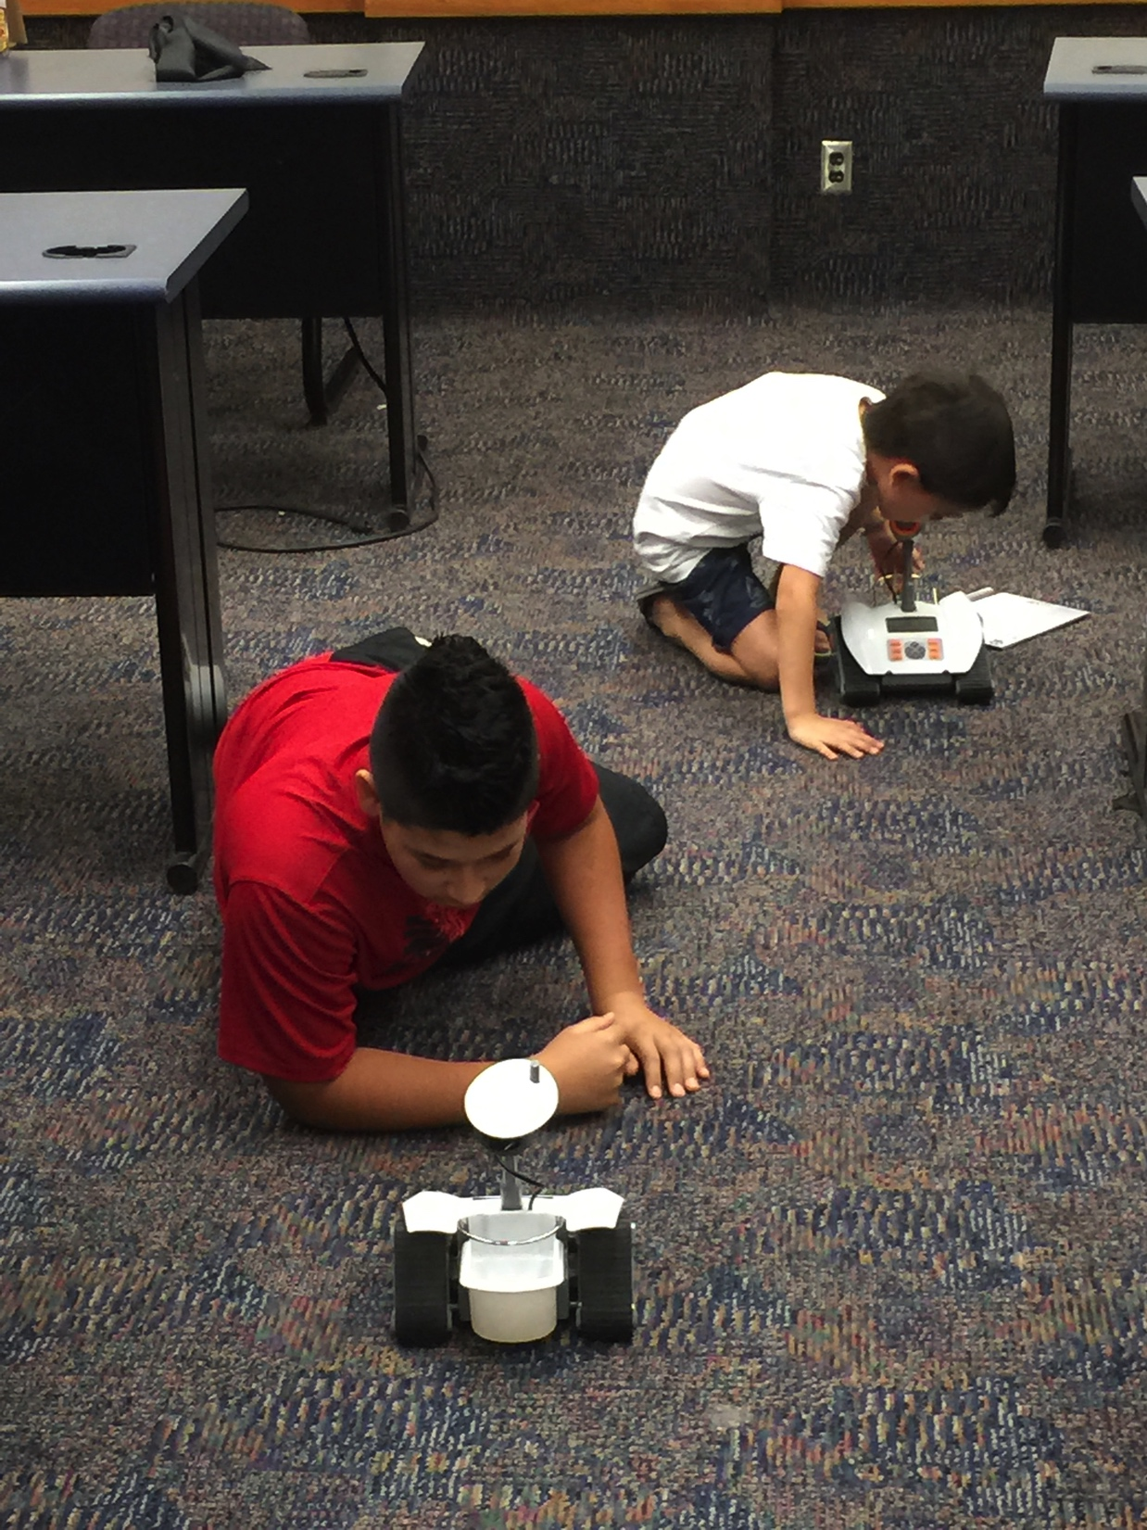
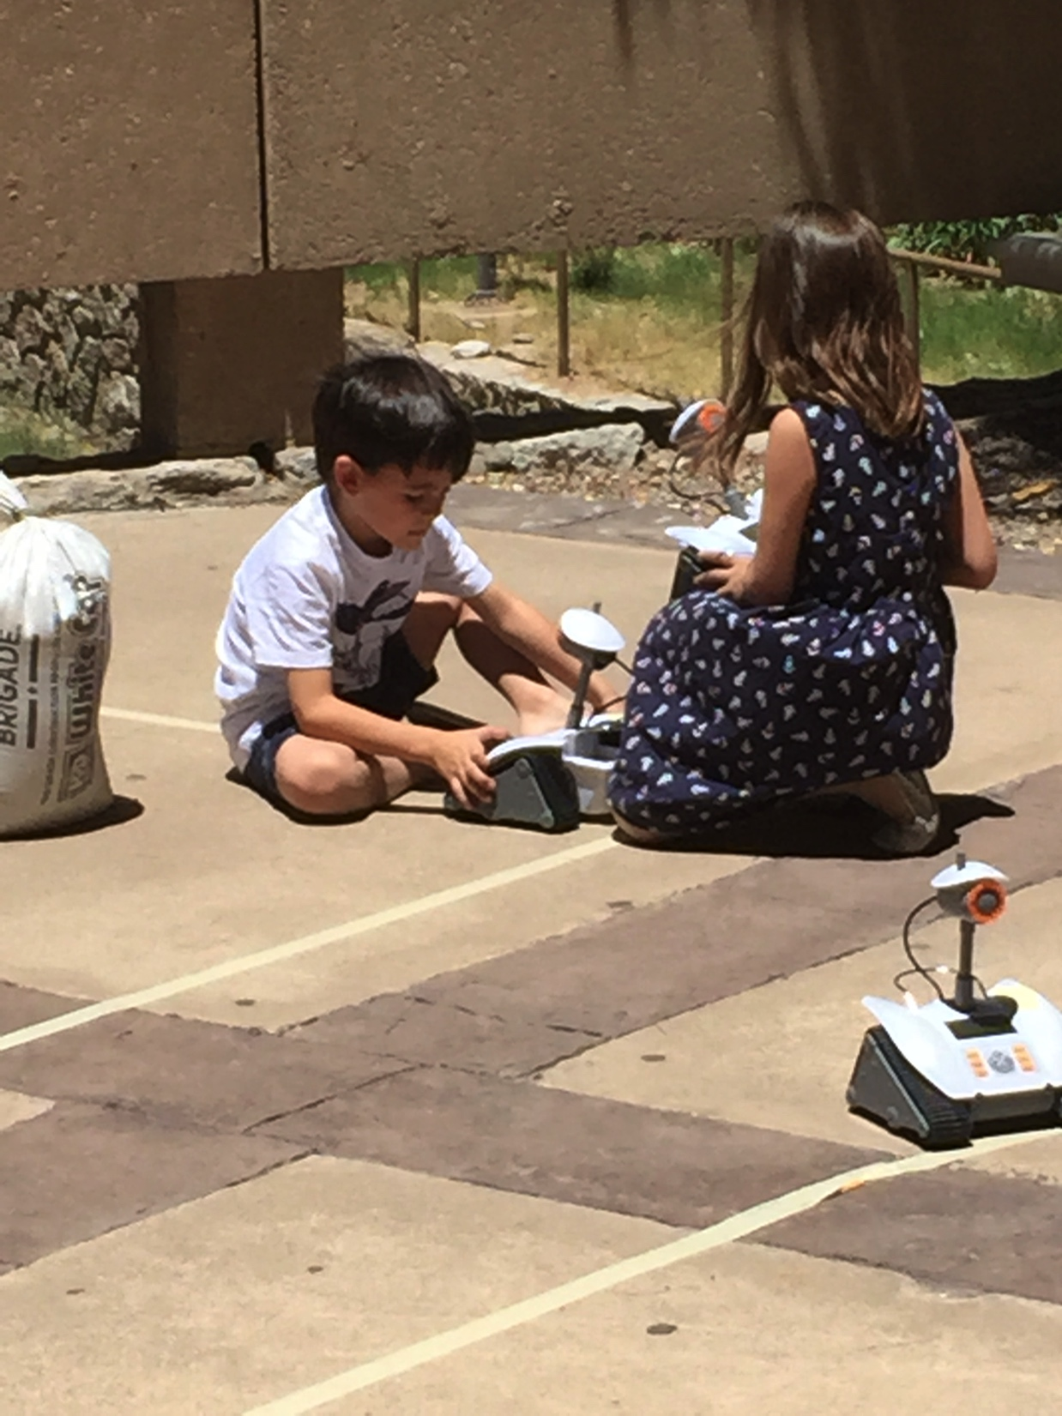

Slide 13
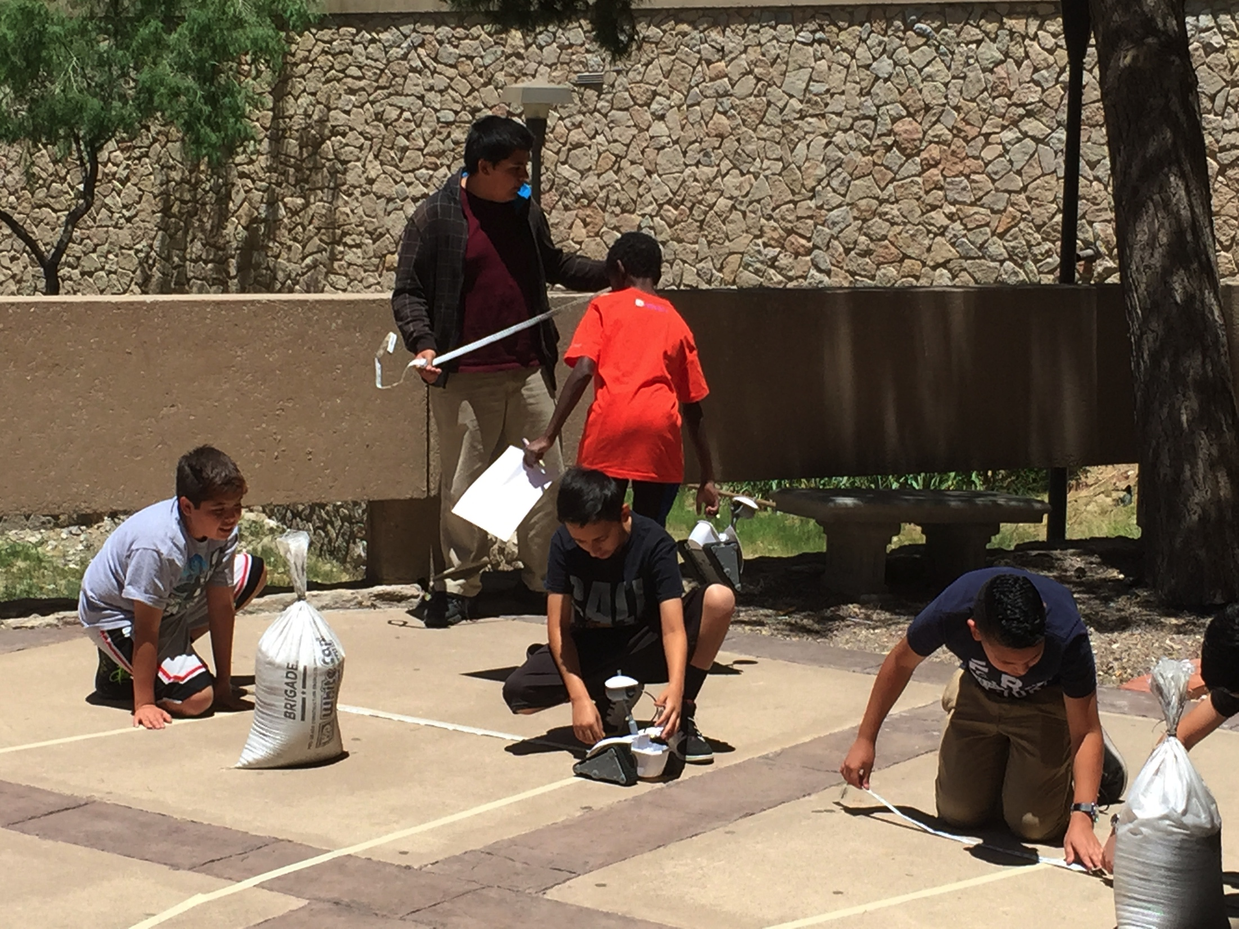

Slide 14
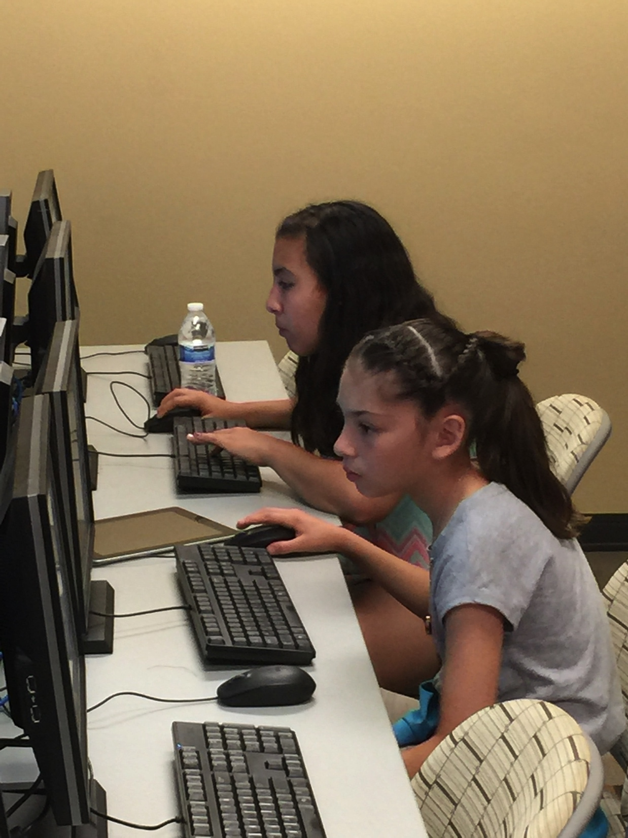
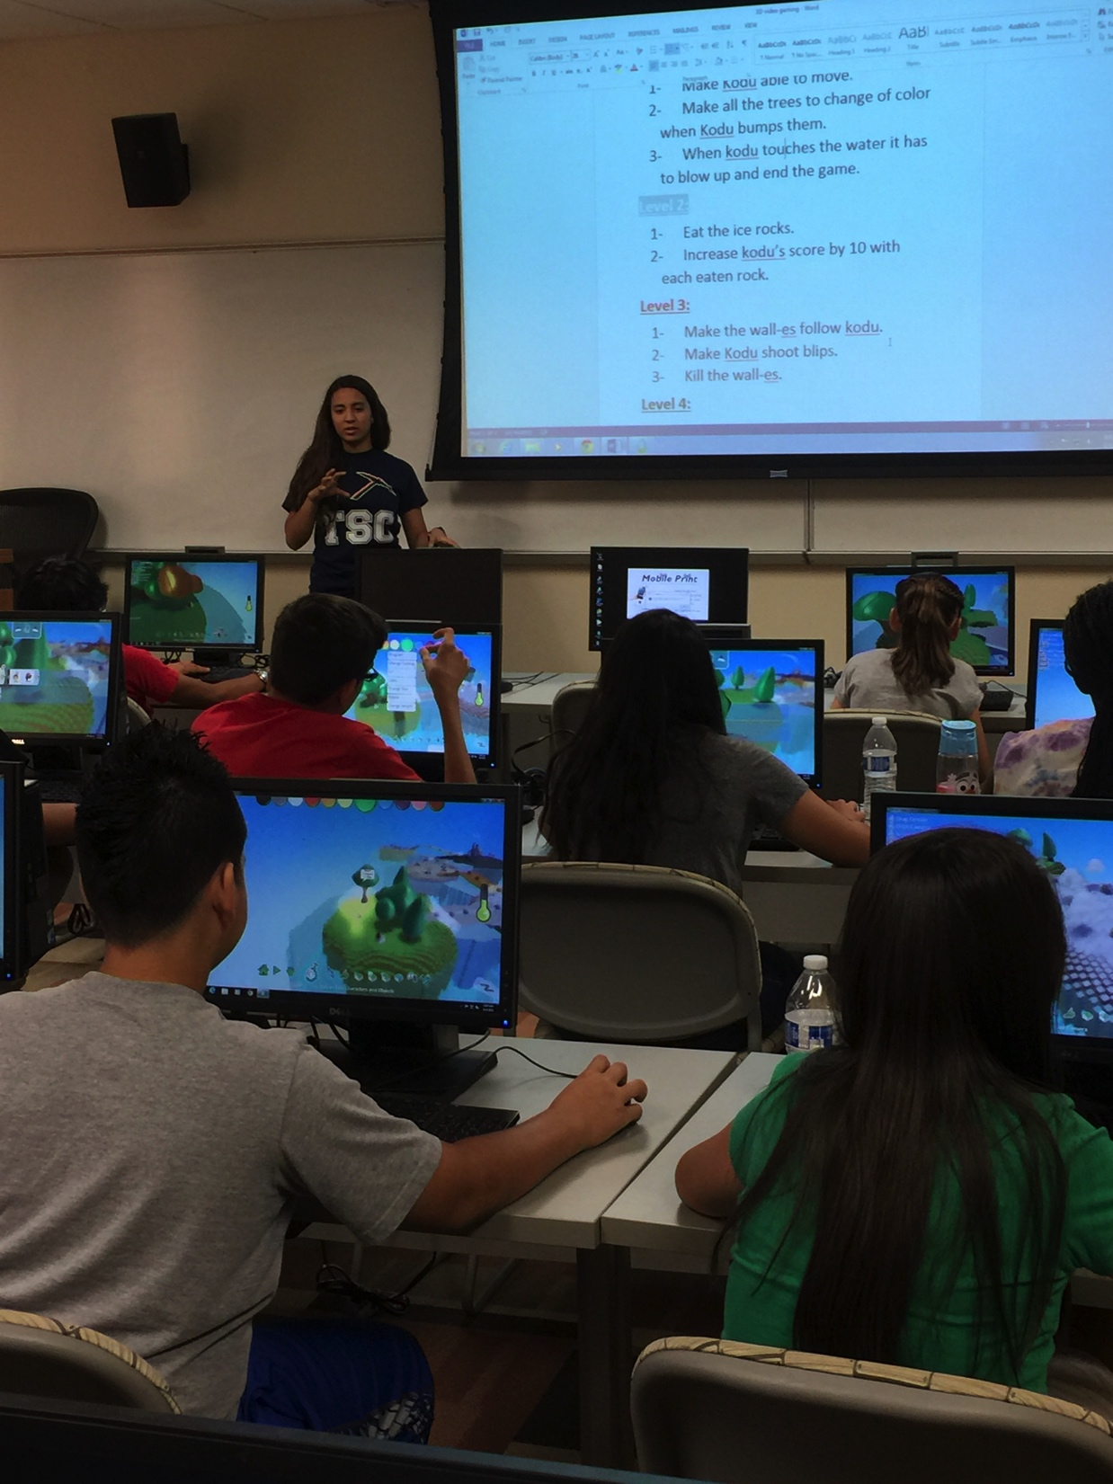

Slide 15
Examples outside CS or Math
Social Studies:
Pose (somehow) open-ended problems and have the students work on a systematic approach to solving them → e.g., the IDEAL framework
Ask students to design a video, create a video game, design an app, etc. that addresses a problem presented in social studies
You can use programs like Scratch
More advanced (more time): robots, lego mindstorm?
E.g., identifying a problem, designing and building a solution

Slide 16
Examples outside CS or Math
Music:
Plug it in an animated video
Have students design music with computers: creation of scales, etc.
Languages:
Same as with music but with text for practice
English as a Second Language: using a simple programming language (like scratch or logo or even python turtle) can help students manipulate English at different levels (programming language, but also their project)

Slide 17
My Own Experience

Slide 18
My own experience
In CS:
I teach CS1: intro to CS & I designed and taught a new Problem Solving course (along with Google)
In CS1: problem-solving and programming (because we solve pbs on computers ☺ )
In Problem-Solving: pure strategy, no coding, no implementation
I also currently teach Logical Foundations of Computer Science, a graduate course
Outside CS:
Worked with a French teacher (using Scratch)
Worked with ESL teacher

Slide 19
Main Goals
Keeping the interest of the students up:
Motivation: purpose and relating topics to their everyday lives
Acknowledgment: they know a lot already. I am just there to help them make sense of their skills → asset-based teaching
Providing valuable training to my students
Equipping them with skills of value across disciplines

Slide 20
How can we do this?
Purpose:
Use videos to show students what Computer Science is: code.org is a great resource
Give students projects that are relevant
Relevance: Share with them the accomplishments of people in CS (make sure to include diversity: women, other minorities, and culturally-relevant environment)
Acknowledgment of their prior skills: relate the topics to “real-life” common tasks and activities + be casual (show trust)
E.g., algorithms: unplugged activities, robots
Recursion, repetitions: CS unplugged
Arrays and Linked-lists: rows of houses vs Treasure Hunt, Monkeys in a barrel
Etc.

Slide 21
Examples of Activities
Activities to do together in the classroom:
1. Robot activity: it makes them stretch and work in teams
2. Recursion: counting together
3. Looking for an element in an array (logic & storage): looking for an image on a computer screen for instance
4. Linked-lists manipulations: monkeys in a barrel, balloons, etc.
And you can come up with many more!
Computer Science rests on computational thinking (algorithms, problem-solving). You can teach mostly without computers!

Slide 22
Getting Started!

Slide 23
How to get you started?
Visit the resources mentioned in this presentation
But I am also happy to:
Help you design activities to get you started on your individual courses
Provide tutorials on tools you can use
Provide workshops on how to design class activities around computational thinking
Build an interest group of teachers
Let me know: contact me (mceberio@utep.edu)

Slide 24
What else we can do
Visit your classes (more on this in a few slides)
Give tours and workshops at UTEP to your students
But there are also plenty of other existing opportunities for you and your students already

Slide 25
Existing Opportunities
School Districts can partner with Code.org
Exploring CS: summer professional development
EngageCSEdu: a Google and NCWIT initiative → resources for the classroom
The Hour of Code: First week of December
After-school programs
E.g., with Little Bits: http://littlebits.cc/education
NCWIT AspireIT
Code.org: curricula and ad-hoc activities available
NCWIT AiC

Slide 26
Let’s take a closer look at some of these programs…
NCWIT AiC
Summer Nexus Internships
Excites Summer Camps
The Hour of Code
Google IgniteCS

Slide 27
NCWIT Aspirations in Computing NCWIT AiC (see: http://aspirations.org)
For young women in high-school with interest in Computing
When? Opens early fall annually
What? Short paragraphs informing us (judges) about their interests, experience, and aspirations
What else??
A parallel program for educators
Those who support the participation of women in CS
We need more applicants: I know many do a great job and we do not get a chance to acknowledge them
Having winners raises awareness and interest about computing to your school

Slide 28
NCWIT AiC: Students & Educators
This is a national & regional program
Entering the competition once:
automatically entered to the regional competition (if any): there is El Paso
automatically entered to the national competition
What’s in it for the participants?
members of a closed group of past participants
scholarships in some universities
prestigious award
monetary prize for educators
laptops for students
Etc.

Slide 29
Nexus Internships
What?
Shadowing program in Engineering at UTEP
In my lab: it is more than shadowing
coding (incl. scratch, java, matlab), presenting, preparing and pitching 2 projects, command line, research (as running tests for our algorithms), etc.
When?
Regular semesters or summer
In my lab: only in summer
Who?
High-school students

Slide 30
Excites Summer Camps
For middle to high-school students
Many different engineering topics
Some camps are focused on CS
NOTE: We can design summer camps in problem solving for instance, with emphasis on / or synergy with humanities (social studies, languages, etc.)

Slide 31
Other Ways to Ignite CS
The Hour of Code: http://hourofcode.org
Annual event
Also available all year long
Easy to organize
We can help!

Slide 32
Other Ways to Ignite CS
Google IgniteCS:
College students offering CS programs in K-12 schools
UTEP’s ACM-W chapter has run IgniteCS programs since January 2015
Let us know if you are interested

Slide 34
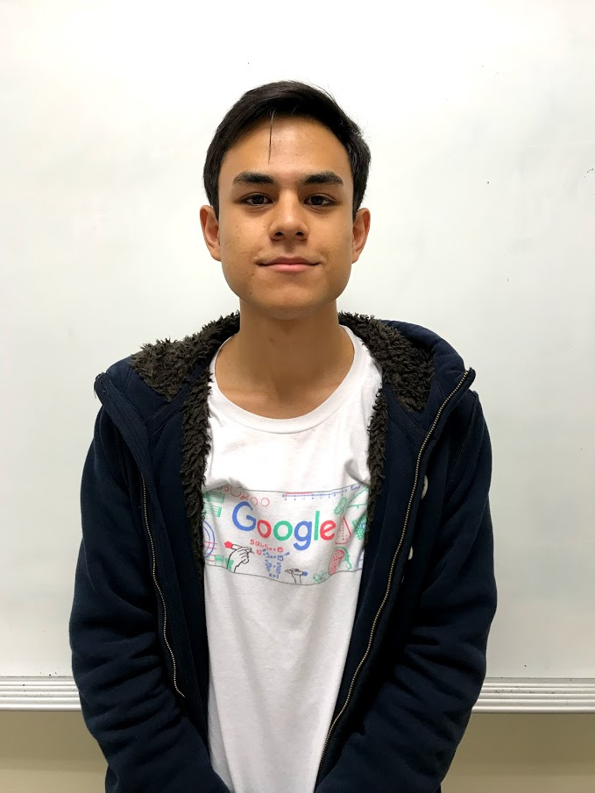
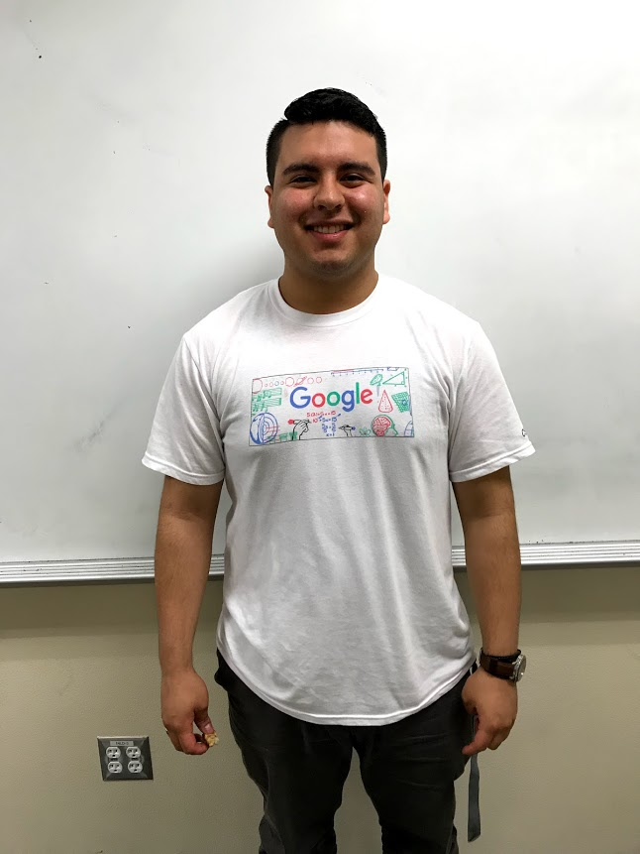
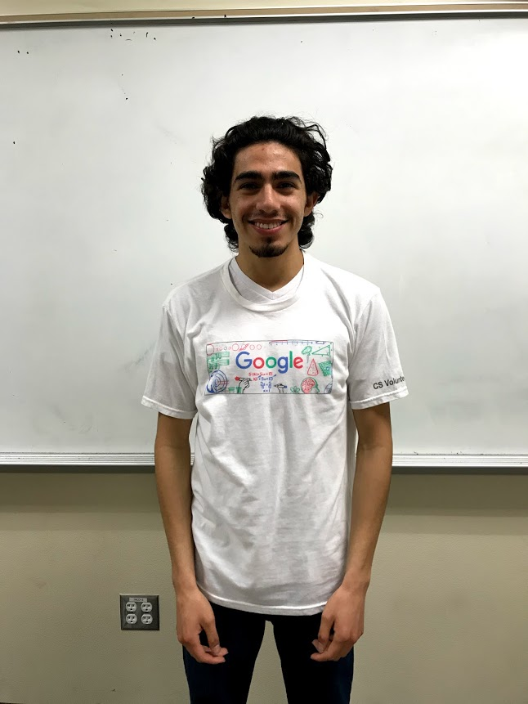
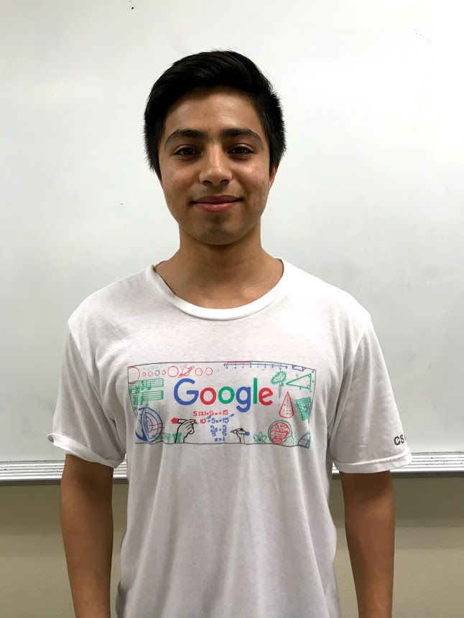
Our Team:
A group of passionate UTEP CS students
Kevin Apodaca
Matthew Montoya
Alejandro Villarreal
Program Manager
Project Lead
Secretary / Public Relations
Hernan Garcia
Carlo Alvarado
Wan Koo
Mentor
Mentor
Mentor

Slide 35
Our Goal
Spark a passion for computer science in young students in the El Paso community
through mentorship.

Slide 36
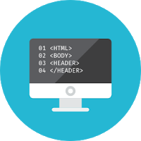
Our Program
Focused on engaging students through
unique activities involving:
Computational Thinking
Problem Solving
HTML & CSS
Python Programming
Notes:
This slide leads into the next which is a promo video. The video is set to play automatically

Slide 37
We are looking to expand for the 2018-2019 academic year
2015-2016: St. Patrick’s MS
2017-2018: El Paso HS
2018-2019: Your school could be it!
Elementary, Middle, or High

Slide 38
Committed Students
Admin Support
Campus Technologist Support
Faculty would help out reinforce our ideas, carry out our lesson plans.
Campus technologists would help us with installing temporary software, allowing pass-through for certain web servers or applications.
Dedicated students willing to learn the basics and essentials of the field of computer science.
Afternoon Sessions
Instructor Support
Clear, Consistent Communication
Afternoon in-class sessions to accommodate our mentor’s schedules.
Instructors would help us reinforce ideas, successfully implement our lesson plans.
For a successful program, we want to always be on the same page with admin, faculty, & students

Slide 39
Contact Us
Email:
members@igniteCS-utep.org (NOT .edu)
Voicemail:
(269) 332-1604
(Leave inquiries & contact information)

Slide 40
Why is all of this important?
Because:
We need to inform young students about what CS is: so they can make informed decisions
We need more people in CS: many jobs (and even more going forward) will require knowledge of CS, or at the very least strong computational thinking
We need diversity in CS (currently not diverse)
We need skilled people
But also: because we need SKILLED THINKERS

Slide 41
Thank you!
Questions?
Martine Ceberio Associate Professor of Computer Science The University of Texas at El Paso mceberio@utep.edu
http://martineceberio.fr

Slide 42
References
Google for Education: https://edu.google.com/resources/programs/exploring-computational-thinking/
Problem Solving @ UTEP: http://martineceberio.fr/blog/problem-solving-computer-scientists
Code.org (http://code.org)
Exploring CS: http://www.exploringcs.org/for-teachers-districts
EngageCSEdu: https://www.engage-csedu.org
The Hour of Code: https://hourofcode.com/us
Little Bits After-school program: http://littlebits.cc/education
NCWIT AiC: http://aspirations.org
NCWIT AspireIT: https://www.ncwit.org/project/aspireit-k-12-outreach-program

